Slide 1
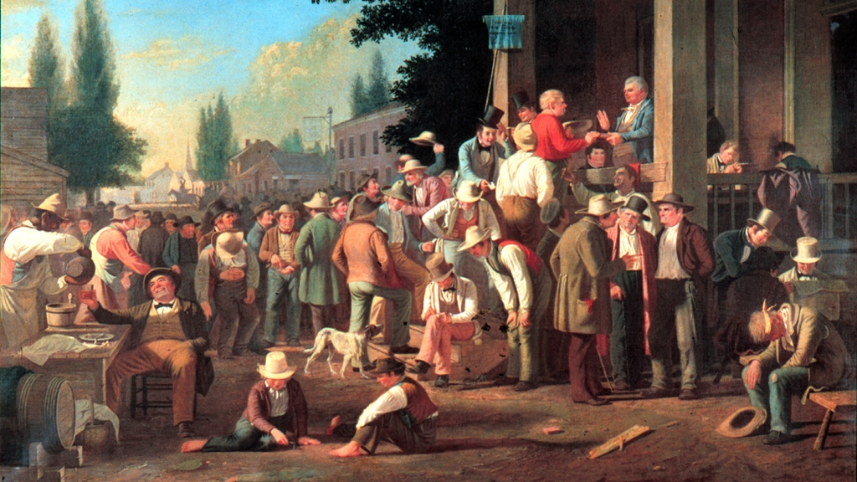
Civics Literacy Program:
Political Parties and Voting in America

Slide 2
Civics Literacy Program:
Political Parties and Voting
COURSE LEARNING OBJECTIVES :
Students will have a better understanding of how the government of the United States is structured; how it works, and their roles and responsibilities within it.
LESSON LEARNING OBJECTIVES:
1.3.1 What is a political party?
1.3.2 What are the major functions of political parties?
1.3.3 What are the universal requirements for voting in the United States?
1.3.4 How do voters elect those who will serve in public office in the United States?

Slide 3
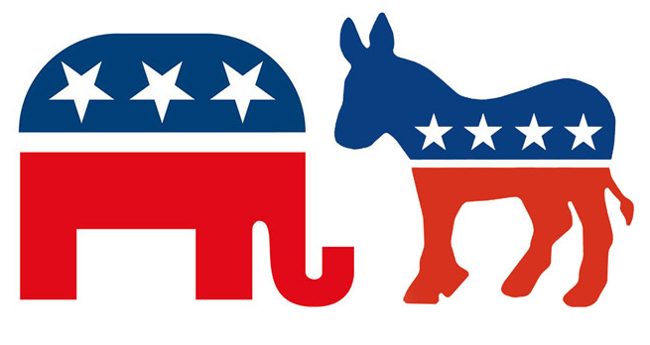
What is a political party?
A political party is a group of persons joined together who seek to control government through the winning of elections and holding public office.
In doing so they seek to control government in order to affect certain public policies and programs.
In the United States there are two major political parties: The Democratic party and the Republican party

Slide 4
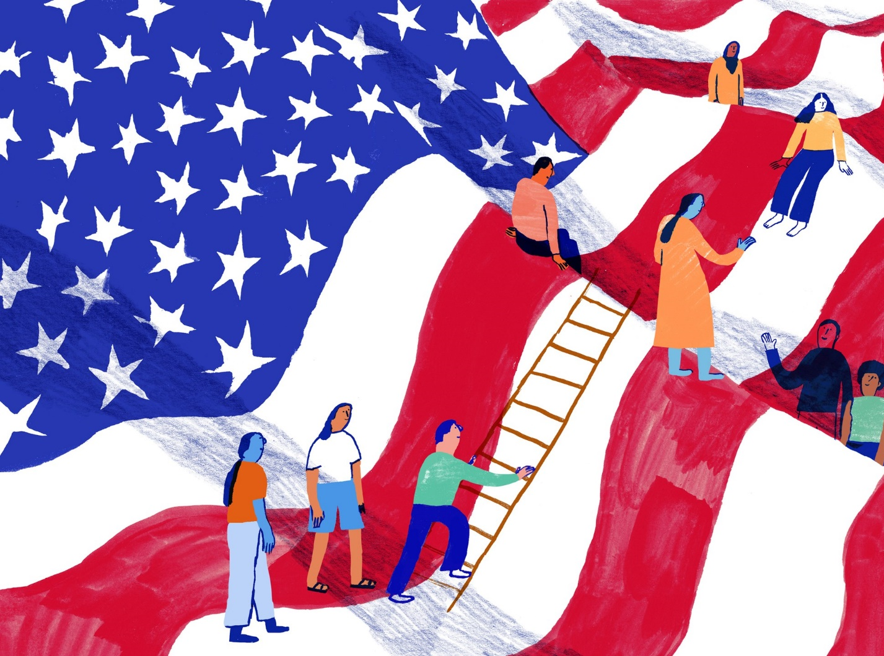
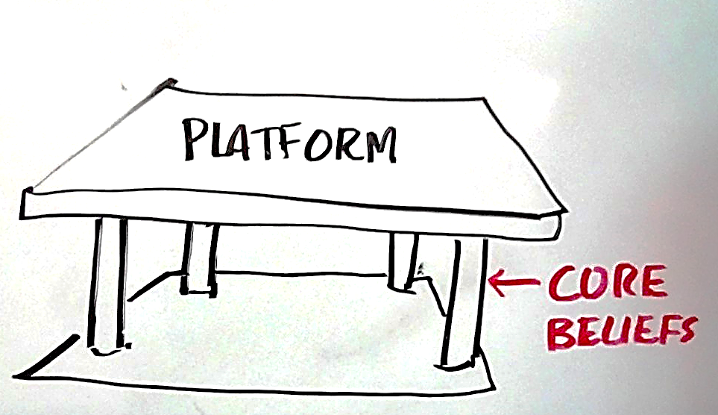
What are the major functions of political parties?
They develop and shape public policy
They modify debate over public policy, seeking consensus
They nominate candidates for office that are qualified and of good character
Inform voters of policy differences
They govern when in office
They act as watchdog over the party in office

Slide 5
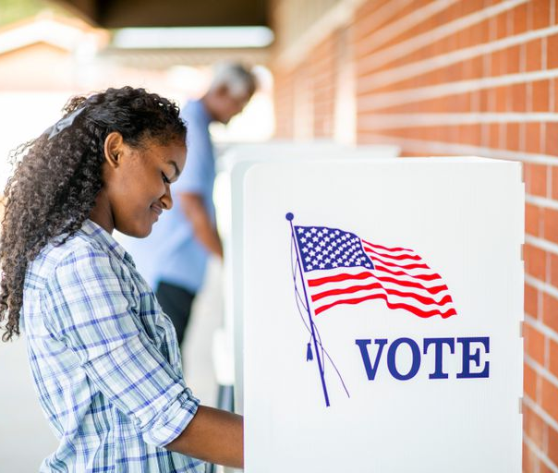
What are the universal requirements for voting in the United States?
Every state has four qualifications for voting:
Citizenship: Foreign-born residents who have not become citizens are generally denied the right to vote in the United States. However, nothing in the CONUS says that they may not, and states may permit them if they so choose.

Slide 6
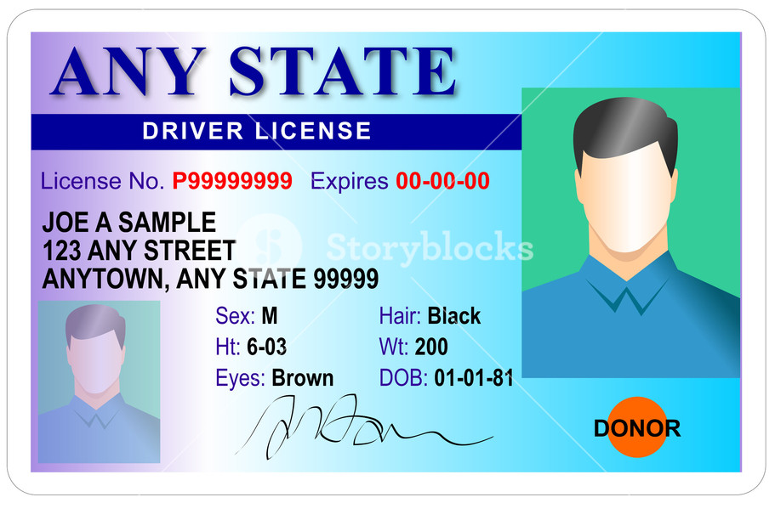
What are the universal requirements for voting in the United States?
Residence: In order to vote, one must be a legal resident of the State in which he or she wishes to cast a ballot.
In most states a person must have lived in the State for certain period of time before he or she can vote.
The residency requirement prevents two things:
prevent outsiders from affecting the outcome of local elections
allows new voters time to become familiar with local candidates and issues

Slide 7
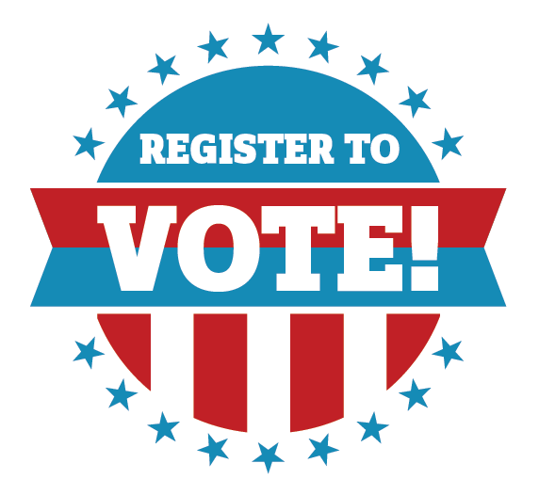
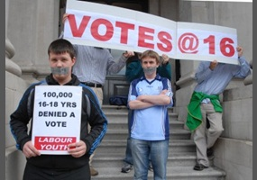
What are the universal requirements for voting in the United States?
Age: In accordance with the 26th Amendment to the ConUS, no state may set the minimum age for voting in any election at more than 18. However, states may set the age limit lower if they so choose.
Registration: All states, except one (ND), require that voters be registered to vote.
Registration is a procedure of voter identification intended to prevent voter fraud by giving election officials a list of those persons who have met the previous qualifications to vote

Slide 8
How do voters pick those who will serve in public office in the United States?
① Persons seeking office announces that they are running
② After a certain campaign period, there is a primary election, in which only those voters who are register within the candidate’s party are allowed to vote.
③ The winner is that party’s candidate for that particular office
④ Following another campaign period, there is a general election between the two candidates representing their respective parties in which all registered voters may cast a ballot.
⑤ The winner of the general election takes the office.

Slide 9
Civics Literacy Program:
Political Parties and Voting
COURSE LEARNING OBJECTIVES :
Students will have a better understanding of how the government of the United States is structured; how it works, and their roles and responsibilities within it.
FOCUS QUESTIONS:
1.3.1 What is a political party?
1.3.2 What are the major functions of political parties?
1.3.3 What are the universal requirements for voting in the United States?
1.3.4 How do voters pick those who will serve in public office in the United States?

