Slide 1
Civics Literacy Program:
Intro to Navigating the US Constitution

Slide 2
Civics Literacy Program:
Navigating the US Constitution
COURSE LEARNING OBJECTIVES :
Students will have a better understanding of how the government of the United States is structured; how it works, and their roles and responsibilities within it.
LESSON LEARNING OBJECTIVES:
1.1 Navigate the US Constitution to find roles, responsibilities, and powers of the branches of government
1.2 Cite the US Constitution
LESSON LEARNING ACTIVITY: Place study guide inserts into pocket Constitutions (Blue Books) and practice navigation and citation

Slide 3
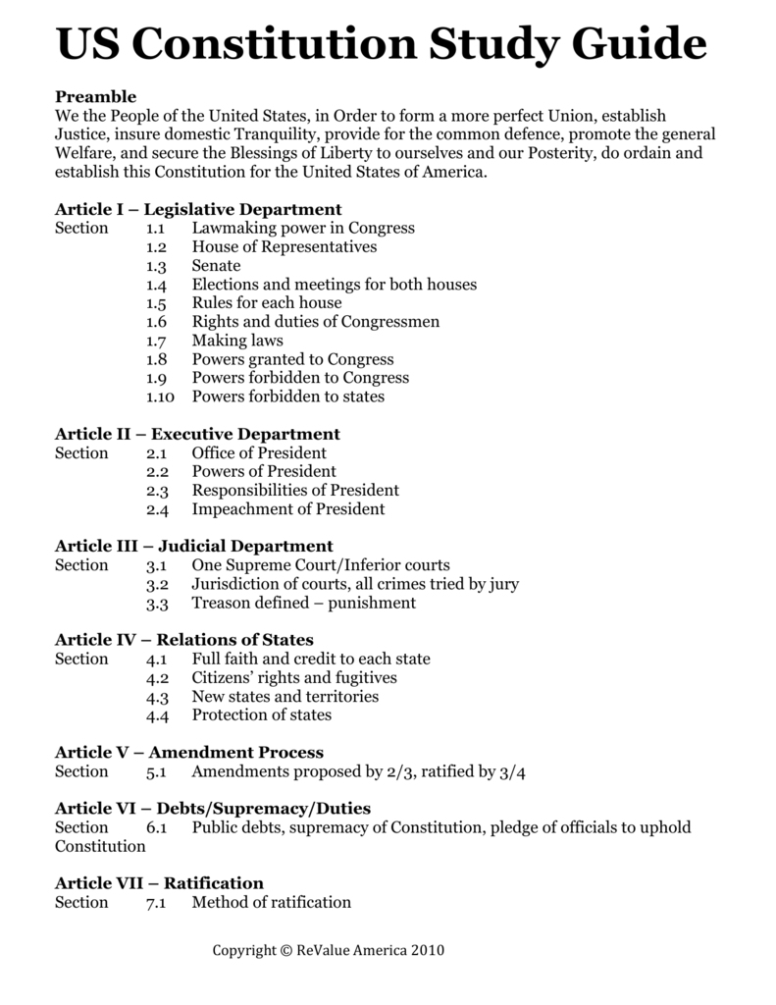
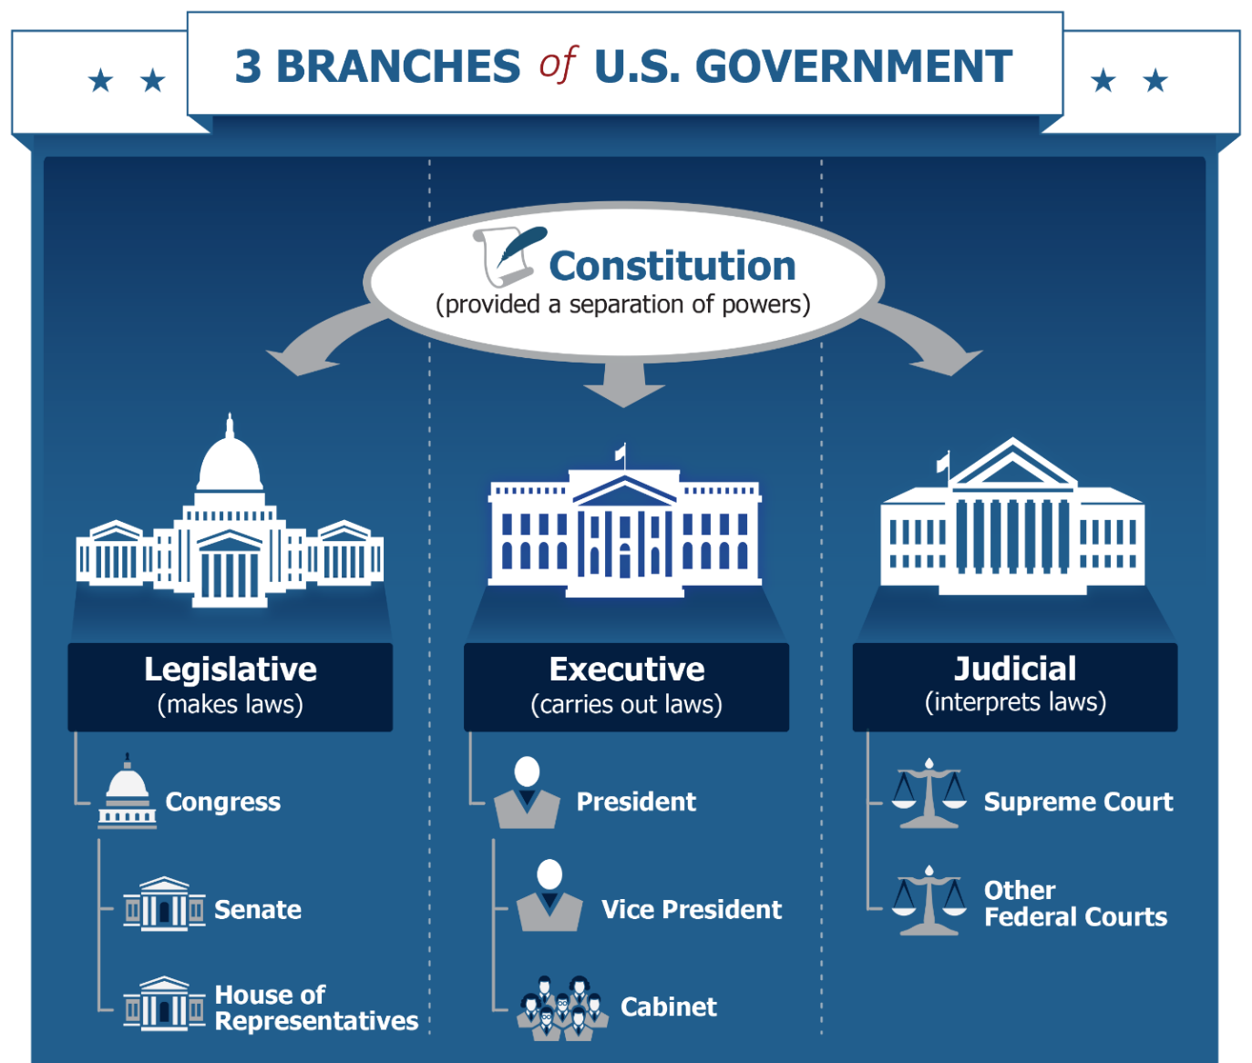
How is the US Constitution Structured?

Slide 4
How do you cite the US Constitution?
EXAMPLE:
Problem: A bill is voted on by the US Senate resulting in a tie (50 for and 50 against). How is this resolved?
Solution: IAW Article I, Section 3, Paragraph 4 of the CONUS, The Vice President of the United States, in his/her role as the President of the US Senate would cast the tie-breaking vote.

Slide 5
How do you cite the US Constitution?
PRACTICE 1:
Problem: Mr. Jermain Jackson wishes to run for POTUS. He is 50 years old; born and raised in Tennessee; and has resided within the country for the past 10 years. Is he eligible? Explain and cite your answer.
Solution: IAW Article II, Section I, Paragraph 5 of the CONUS, Mr. Jackson is not eligible to hold office as the POTUS because although he is a natural born citizen and is at least 35 years old, and has not resided within the country for 14 years

Slide 6
How do you cite the US Constitution?
PRACTICE 2:
Problem: How is an amendment to the Constitution made?
Solution: IAW Article V of the CONUS, an amendment may be proposed by 2/3^{rds} of both houses, or states’ conventions, but may only be ratified (approved) by 3/4^{ths} of states legislatures, or their conventions.

Slide 7
Amending the US Constitution
CONSTITUTIONAL AMENDMENT PROCESS
287 in House
67 in Senate
PROPOSAL
RATIFICATION
38 States
3/4^{ths} of states’ legislatures
2/3^{rds} of Congress
OR
OR
2/3^{rds} of states’ conventions
3/4^{ths} of states’ conventions
33 States

