Slide 1
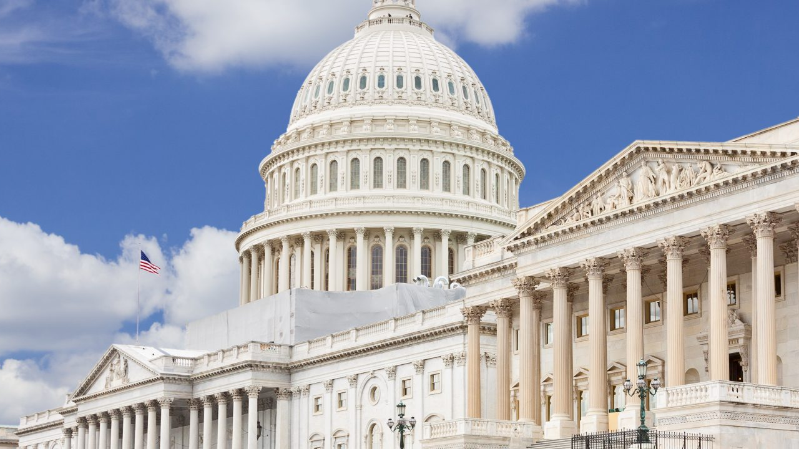
Civics Literacy Program:
Role, Powers and Responsibilities of the Legislative Branch

Slide 2
Civics Literacy Program:
Powers of the Legislative Branch
COURSE LEARNING OBJECTIVES :
Students will have a better understanding of how the government of the United States is structured; how it works, and their roles and responsibilities within it.
LESSON LEARNING OBJECTIVE(S):
4.4.1 What are the major roles, powers and responsibilities of the Congress?

Slide 3
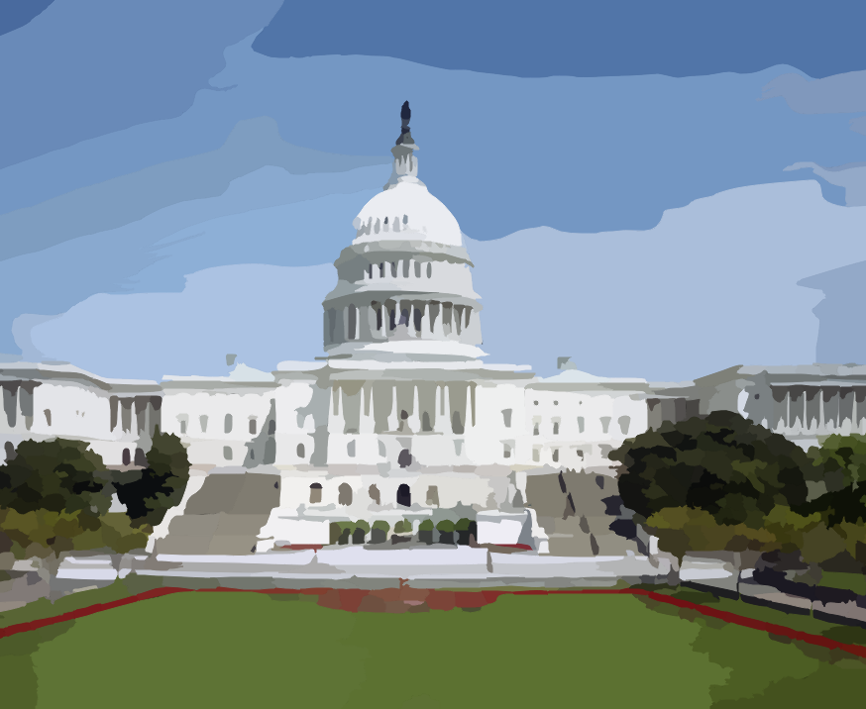
What are the major roles, powers and responsibilities of the Congress?
The Congress has three major roles in American government. Though there are dozens of powers, both expressed and implied, most fall under one of these three categories:
Legislative Powers (Passing Laws)
Non-Legislative Powers
Appropriating (raising) and distributing funds

Slide 4
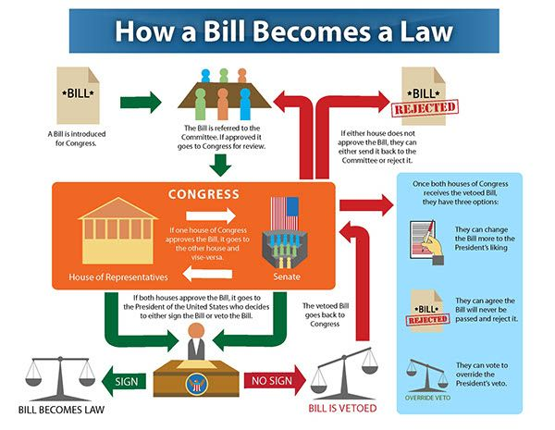

Slide 5
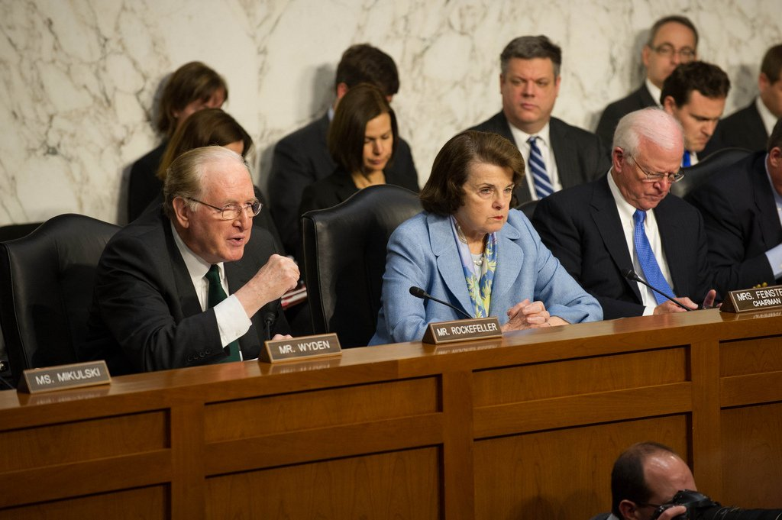
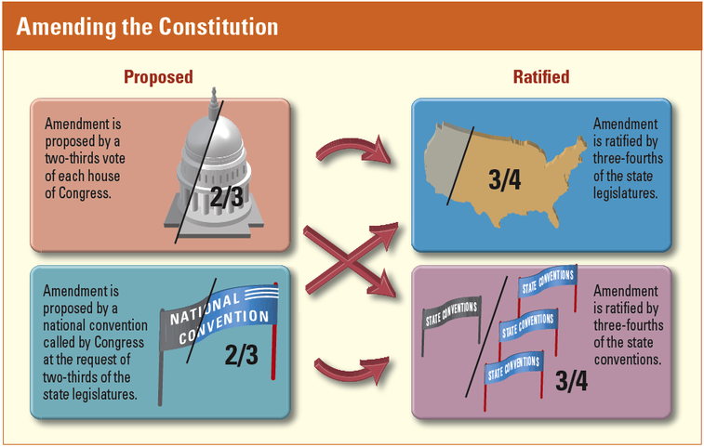
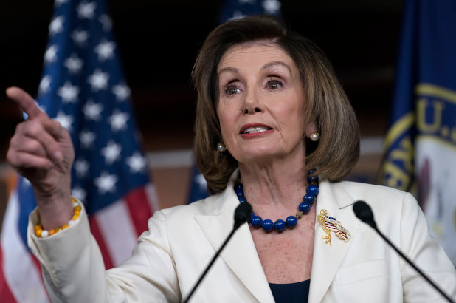
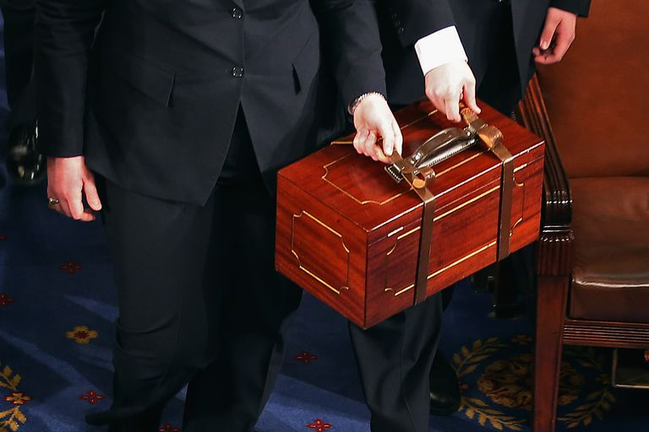
Non-Legislative Powers
Though the Congress is a legislative body with a primary function to make laws, the Constitution gives it other powers and duties to perform to include:
Proposing Constitutional Amendments
Breaking Electoral Tie
Impeachment
Confirmation of Judges and other Officers
Investigatory Power

Slide 9
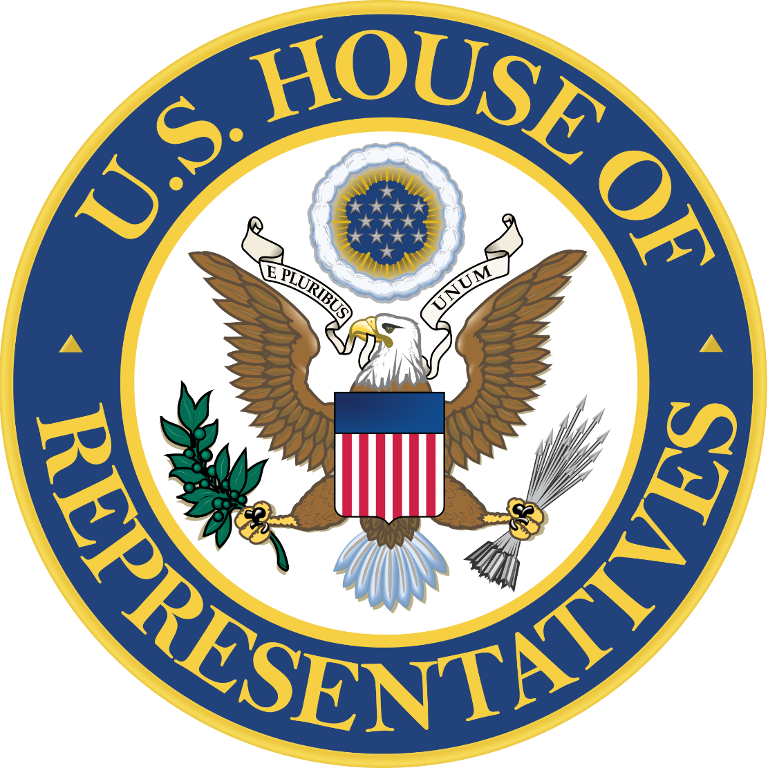
Appropriating Funds (Power to Tax)
The Constitution gives only Congress the power to tax and all bills that raise money MUST originate in the House of Representatives
A tax is charges place on a person/business/property to raise money to meet public needs.

Slide 10
Civics Literacy Program:
Overview of the Legislative Branch
COURSE LEARNING OBJECTIVES :
Students will have a better understanding of how the government of the United States is structured; how it works, and their roles and responsibilities within it.
FOCUS QUESTIONS:
4.4.1 What are the major roles and responsibilities of the Congress?
What are the major steps in a bill becoming a law?
How are Constitutional Amendments made and ratified?
What are the major steps in the impeachment and confirmations processes?

