Slide 1
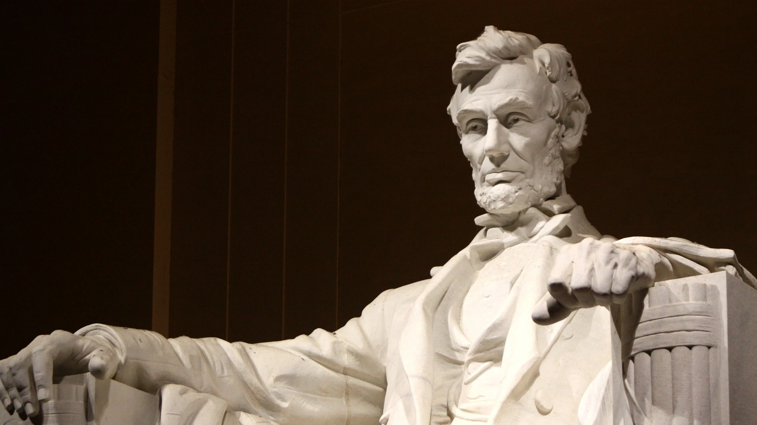
Civics Literacy Program:
Principles of American Government

Slide 2
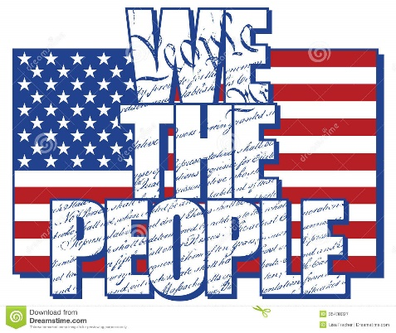
Civics Literacy Program:
Principles of American Government
COURSE LEARNING OBJECTIVES :
Students will have a better understanding of how the government of the United States is structured; how it works, and their roles and responsibilities within it.
LESSON LEARNING OBJECTIVES:
1.2.1 Under the principle of separation of powers, what are the roles and responsibilities of each branch in US government?
1.2.2 Under the principle of checks and balances, what checks does each branch have on the another?
1.2.3 Under the principle of federalism, how are the powers of government divided and shared between the federal government and the states?

Slide 3
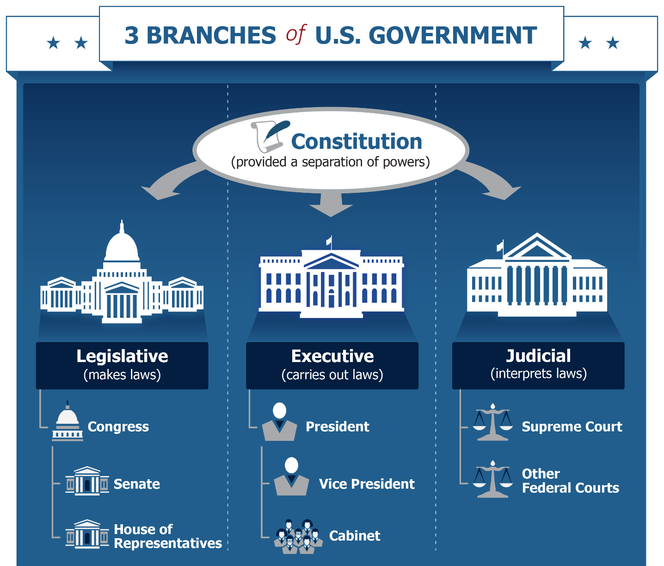
What are the roles and responsibilities of each branch in US government?
Under the Constitution of the United States, there are three branches of government: Legislative (Congress), Executive (President) and Judicial (SCOTUS and other Federal Courts.
Each branch has it own independent powers and role in government that are not shared with the other two. This is called separation of powers.

Slide 4
What are the roles and responsibilities of each branch in US government?
Congress exercises legislative power or the power to make or change laws
The POTUS exercises executive power to execute, enforce, and administer the law
The SCOTUS and Federal Courts exercise judicial power to interpret laws, settle/resolve disputes and protect the rights of individuals/groups

Slide 5
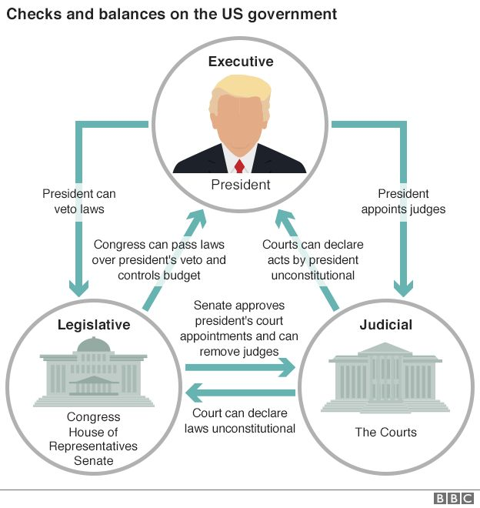
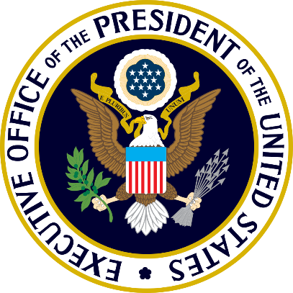
What checks does each branch have on the another?
Each branch also exercises certain powers that limit or restrict the powers of the other two .This is called checks and balances.
Congress exercises the power of impeachment (official removal from office) over each of the other two branches
Congress also has the power of confirmation over the appointment of judges/executive appointments
Congress has the power to over-ride a presidential veto with a 2/3rds majority

Slide 6
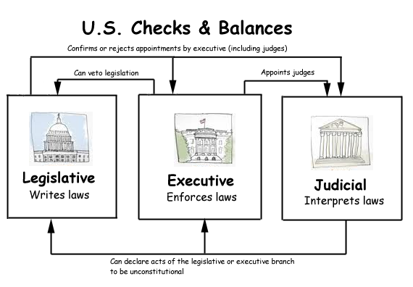
What checks does each branch have on the another?
POTUS has two major checks on the other two branches: he/she exercises veto power (rejection of proposed law) over the Congress
POTUS also has the power of appointment over the Judicial branch

Slide 7
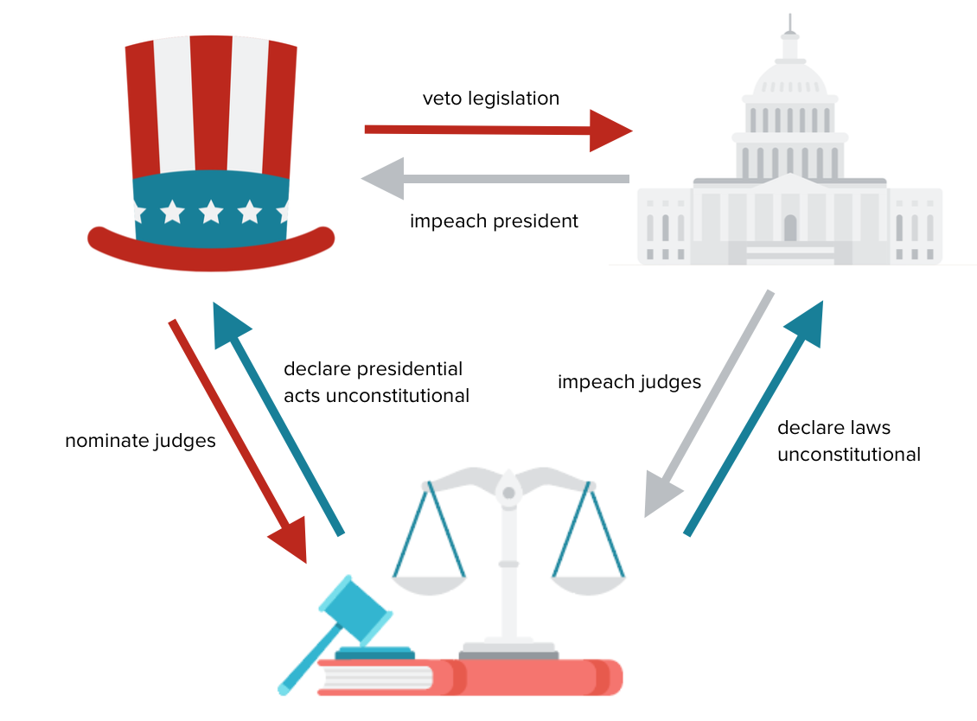
What checks does each branch have on the another?
SCOTUS (and federal courts) have one major check on both others: the power of Judicial Review (authority to declare acts/laws to be unconstitutional and unenforceable)

Slide 8
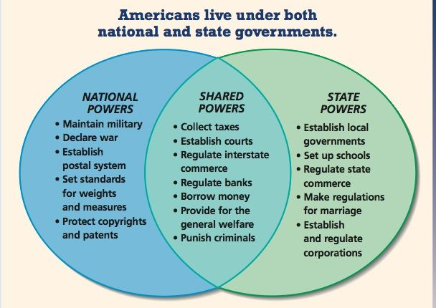
How are the powers of government divided and shared between the federal government and the states?
Under the principle of federalism government power is divided and shared at two levels of government: the national (federal) government and the states

Slide 9
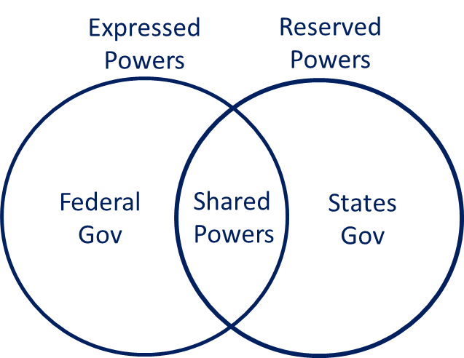
How are the powers of government divided and shared between the federal government and the states?
There are three types of government power in federalism:
Expressed Powers: those powers expressly enumerated (listed) in the CONUS for national government
Reserved Powers: those powers reserved to the states because they are not specifically given to the national government (10th Amendment)
Shared/Concurrent Powers: those powers that each level of government may exercise at the same time

Slide 10
Civics Literacy Program:
Principles of American Government
REVIEW QUESTIONS:
1.2.1 Under the principle of separation of powers, what are the roles and responsibilities of each branch in US government?
1.2.2 Under the principle of checks and balances, what checks does each branch have on the another?
1.2.3 Under the principle of federalism, how are the powers of government divided and shared between the federal government and the states?

