Slide 1
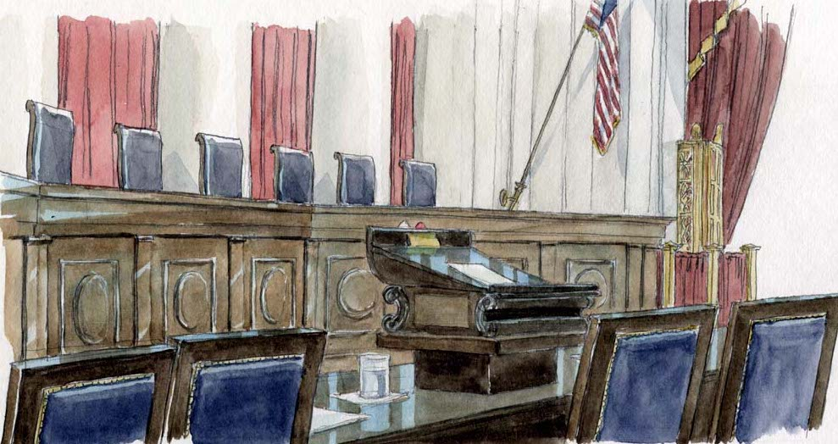
Civics Literacy Program
Historical Supreme Court Decisions

Slide 2
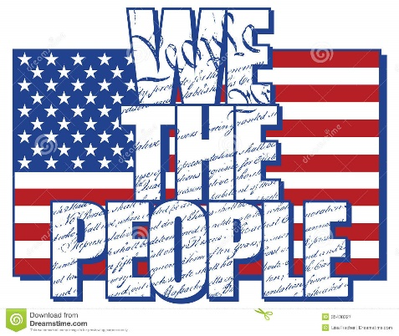
Civics Literacy Program:
Historical Supreme Court Decisions
COURSE LEARNING OBJECTIVES :
Students will have a better understanding of how the government of the United States is structured; how it works, and their roles and responsibilities within it.
LEARNING OBJECTIVES:
1.9.1 How has the SCOTUS expanded government power in historical decisions?
1.9.2 How has the SCOTUS impacted the development and protection of Civil Rights in historical decisions?

Slide 3
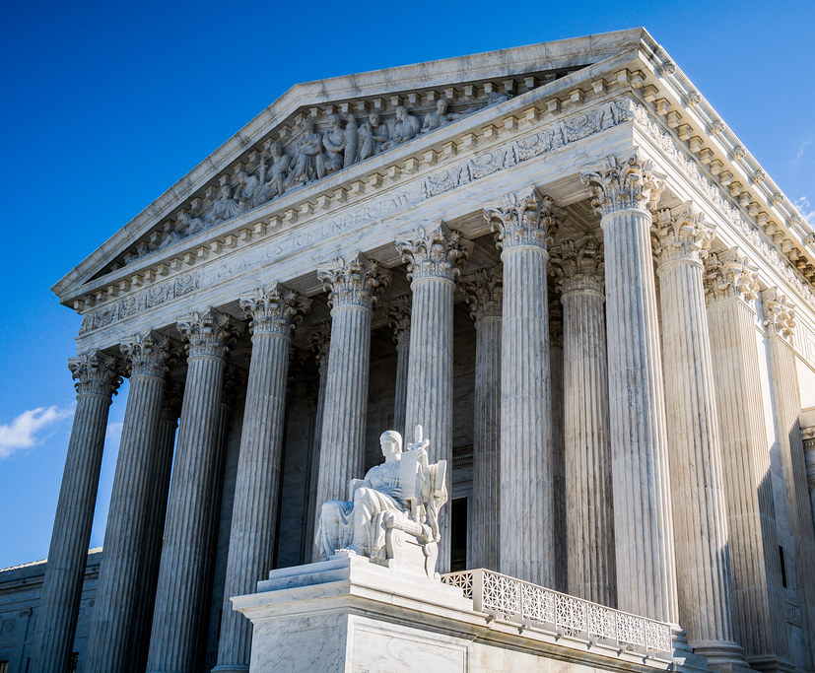
How has the SCOTUS expanded government power in historical decisions?
The are numerous decisions in the history of the SCOTUS that have impacted American government and its relationship with the people by expanding government power or impacted the development and protection of Civil Rights. We will look at six of them.
Marbury v. Madison (1803)
McCulloch v. Maryland (1819)
Gibbons v. Ogden (1824)
Dred Scott v. Sanford (1857)
Plessy v. Ferguson (1896)
Brown v. Board of Education (1954)

Slide 4
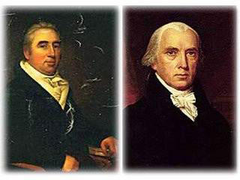
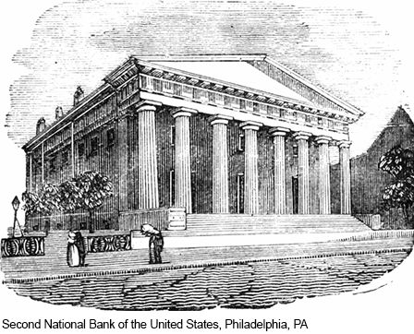
Key Supreme Court Decisions that expanded Government Power in the Early Republic
Marbury v Madison (1803): For the first time the SCOTUS claims, and exercises, Judicial Review, striking down a law passed by Congress and signed into law by the POTUS.
McCulloch v. Maryland (1819): The SCOTUS cites the “Supremacy Clause” in this key decision that determined that states could not tax the federal government and also determined that the “Necessary and Proper Clause” provided that there are indeed implied powers embedded within the CONSUS and therefore the BUS was constitutional.

Slide 5
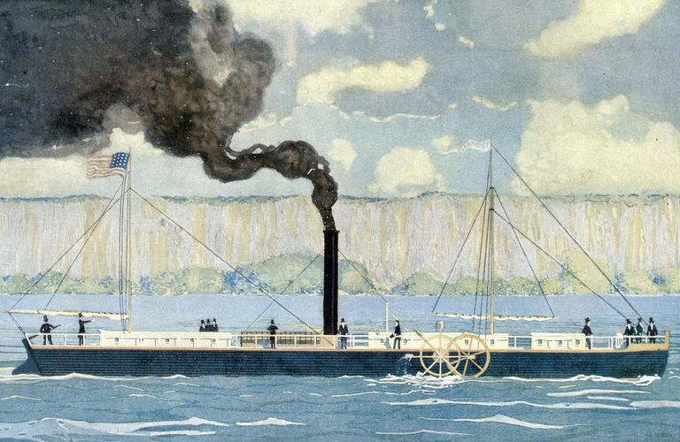
Key Supreme Court Decisions that expanded Government Power in the Early Republic
Gibbons v Ogden(1824): SCOTUS again cites the “Supremacy Clause”, along with the “Commerce Clause”, in its determination that a State’s commerce regulations (in this case: ferry license to and from NYC) cannot take precedence over the Congress’ expressed power to regulate commerce. Served to strengthen the federal governments power to regulate interstate business.

Slide 6
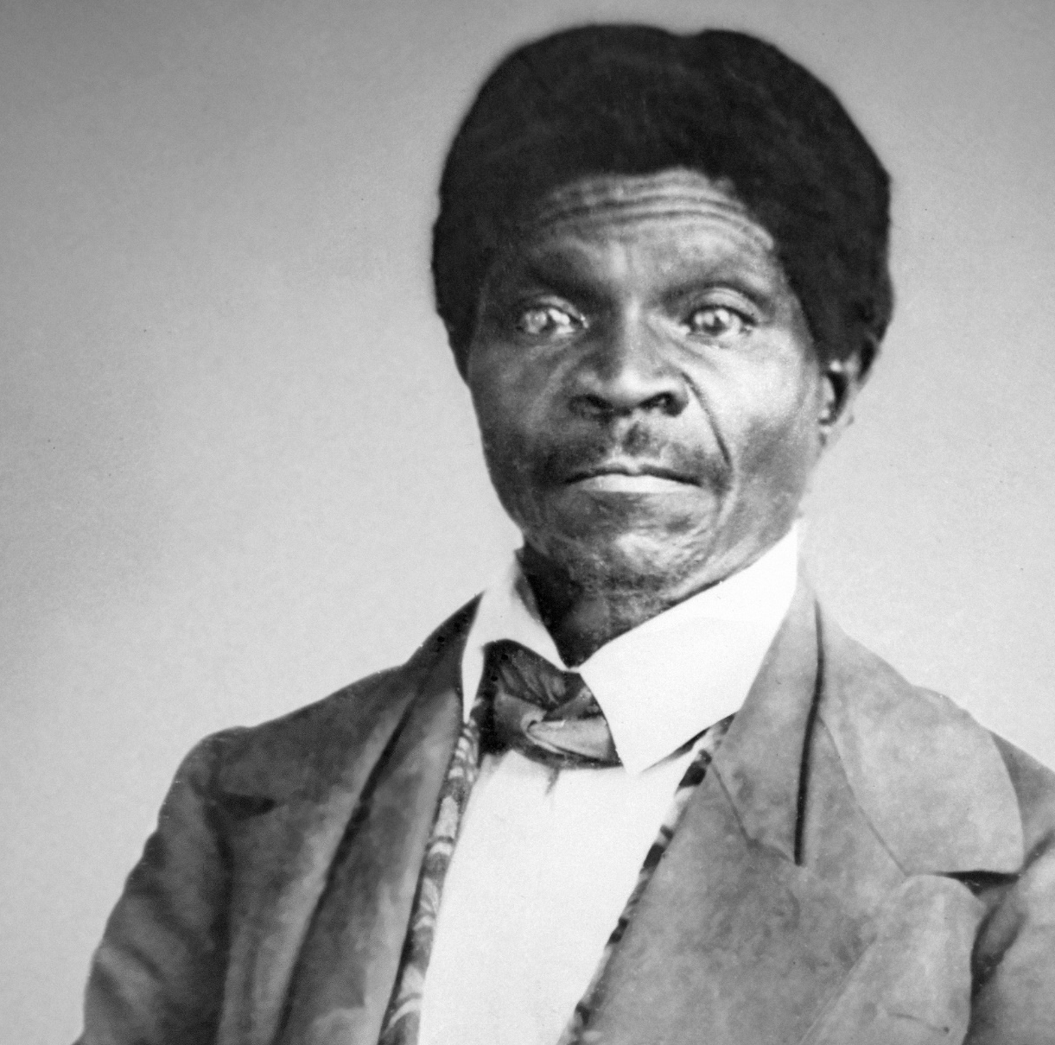
Key Supreme Court Decisions that impacted the development and protection of Civil Rights
Dred Scott v. Sanford(1857): In one of the most infamous decisions in the early history of the SCOTUS, the court held that a slave couldn’t sue for freedom because:
Slaves were not citizens and therefore had no right to bring suit
Since slaves are property, slave owners were entitled to carry their slaves into “Free” territory because they are protected by the 5th Amendment
The government cannot restrict the expansion of slavery into territories

Slide 7
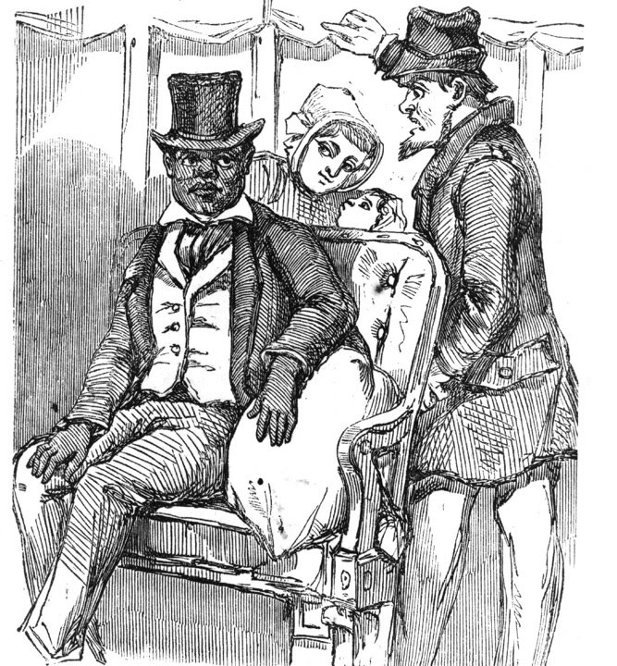
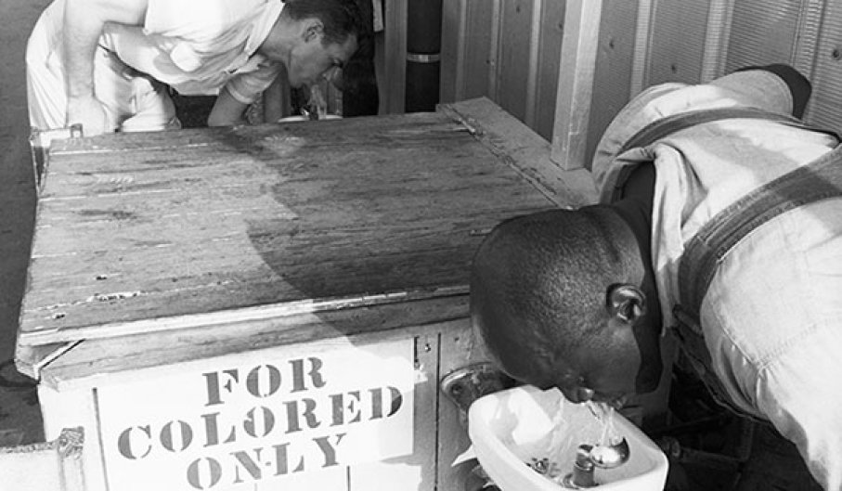
Key Supreme Court Decisions that impacted the development and protection of Civil Rights
Plessy v. Ferguson (1896): SCOTUS ruled that a Louisiana law that provided for separate public facilities for blacks and whites was constitutional and not a violation of the 14th Amendment’s right to “equal protection of the laws” so long as the facilities were equal.
This would become known as the “Separate, but Equal” doctrine and used to justify and expand racial segregation in America for nearly 60 years – Jim Crow

Slide 8
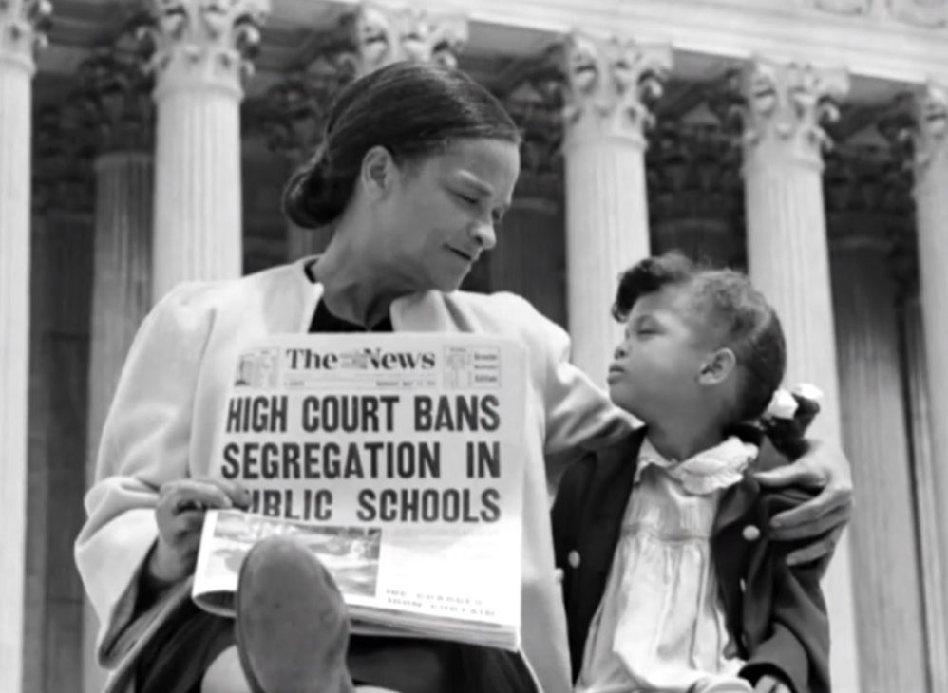
Key Supreme Court Decisions that impacted the development and protection of Civil Rights
Brown v. Board of Education (1954): In perhaps the court’s most socially impactful decision, the SCOTUS strikes down the “separate but equal” doctrine established in Plessy v. Ferguson, finding that it was indeed a violation of the “equal protection clause” of the 14th Amendment. In this case it was public school segregation; however, it had the effect of striking down all previous states’ laws that established/justified racial segregation.

Slide 9
Civics Literacy Program:
The Supreme Court of the United States
REVIEW QUESTIONS:
1.9.1 How has the SCOTUS expanded government power in historical decisions?
Marbury V. Madison (1803)
McCulloch v. Maryland (1819)
Gibbons v. Ogden (1824)
1.9.2 How has the SCOTUS impacted the development and protection of Americans’ civil rights in historical decisions?
Dred Scott v. Sanford (1857)
Plessy v. Ferguson (1896)
Brown v. Board of Education (1954)

