Slide 1
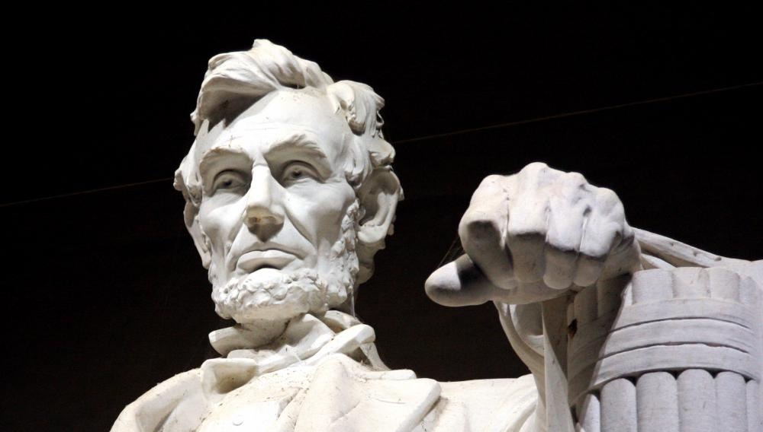
Civics Literacy Program
Roles, Powers and Responsibilities
of the Executive Branch

Slide 2
Civics Literacy Program:
Role, Responsibilities, and Powers of the President
COURSE LEARNING OBJECTIVES :
Students will have a better understanding of how the government of the United States is structured; how it works, and their roles and responsibilities within it.
LESSON LEARNING OBJECTIVES:
1.7.1 What are the primary roles of the POTUS?
1.7.2 What are the primary roles of the VPOTUS?
1.7.3 What are the executive powers of the POTUS?

Slide 3
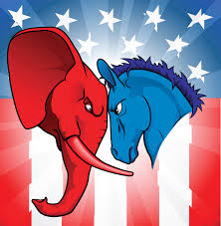
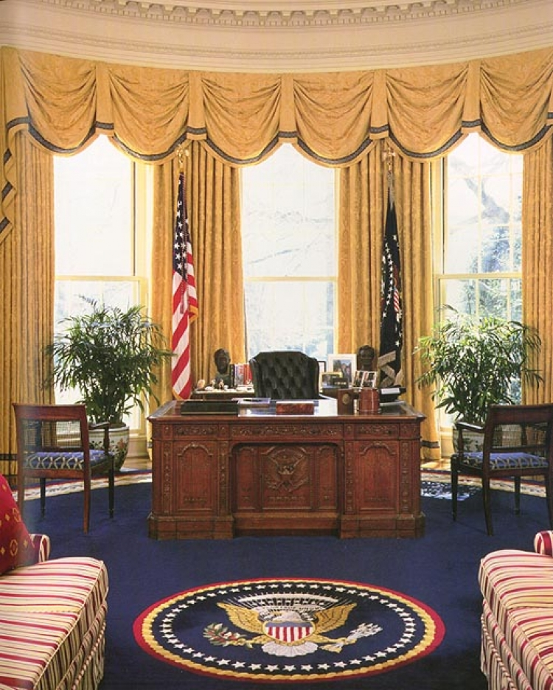
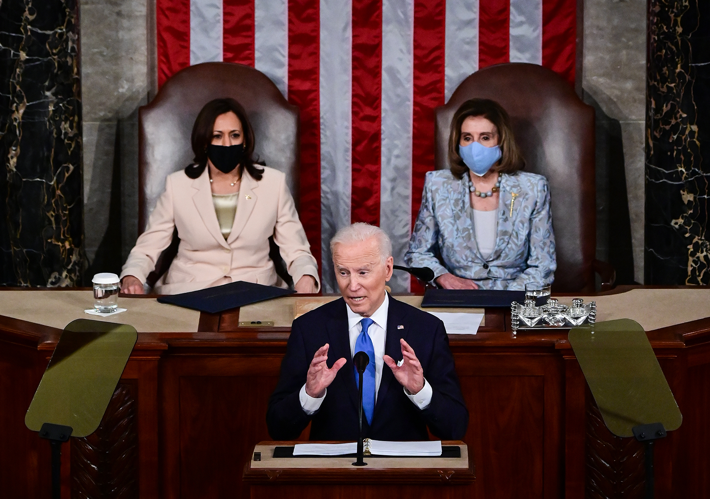
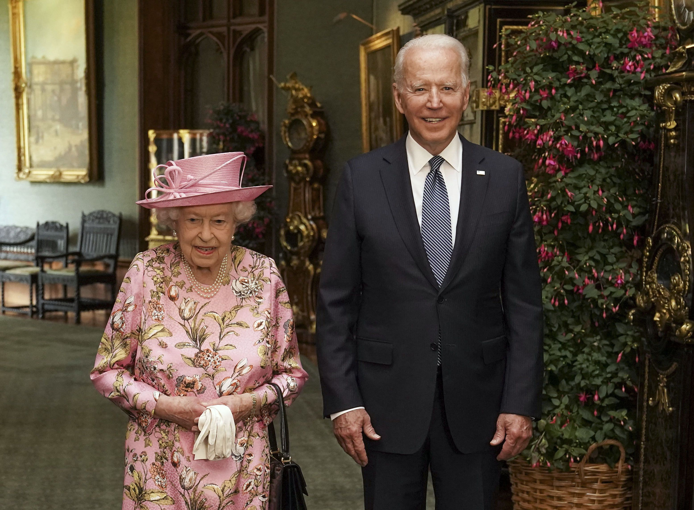
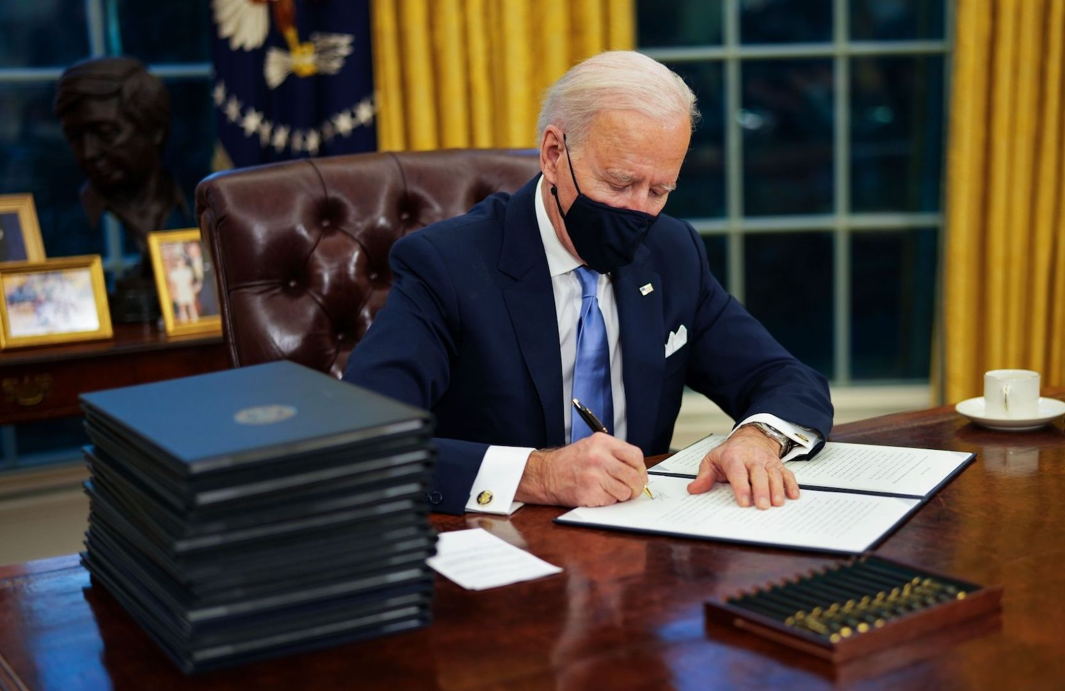
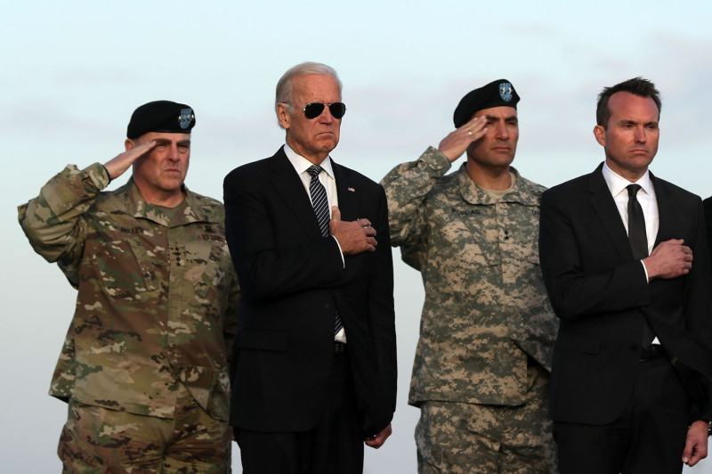
What are the major roles and responsibilities of the President?
The President serves five major roles in American government.
Head of State: Ceremonial head of the government; symbol of all people of the nation
Chief Executive and Administrator: Director of executive branch and of public and foreign policy
Commander in Chief of Armed Forces: Has direct and immediate control of the US military
Chief legislator: sets the agenda for public policy by suggesting, initiating, or demanding major legislation
Head of his political party.

Slide 4
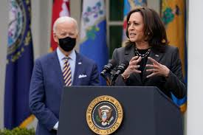
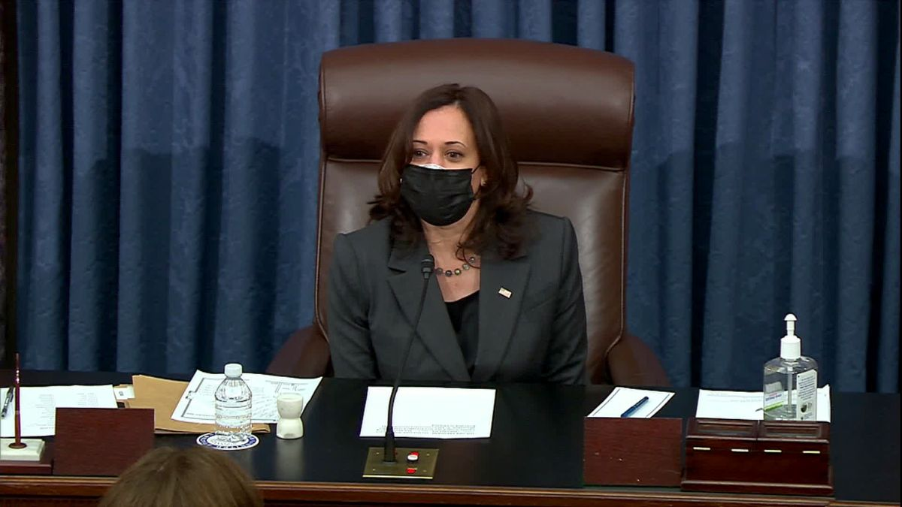
What are the major roles and responsibilities of the Vice-President?
The Vice-President has two formal duties IAW the Constitution:
Preside over the Senate; tie breaker
Helps decide the question of presidential disability (IAW 25th Amendment); first in succession.

Slide 5
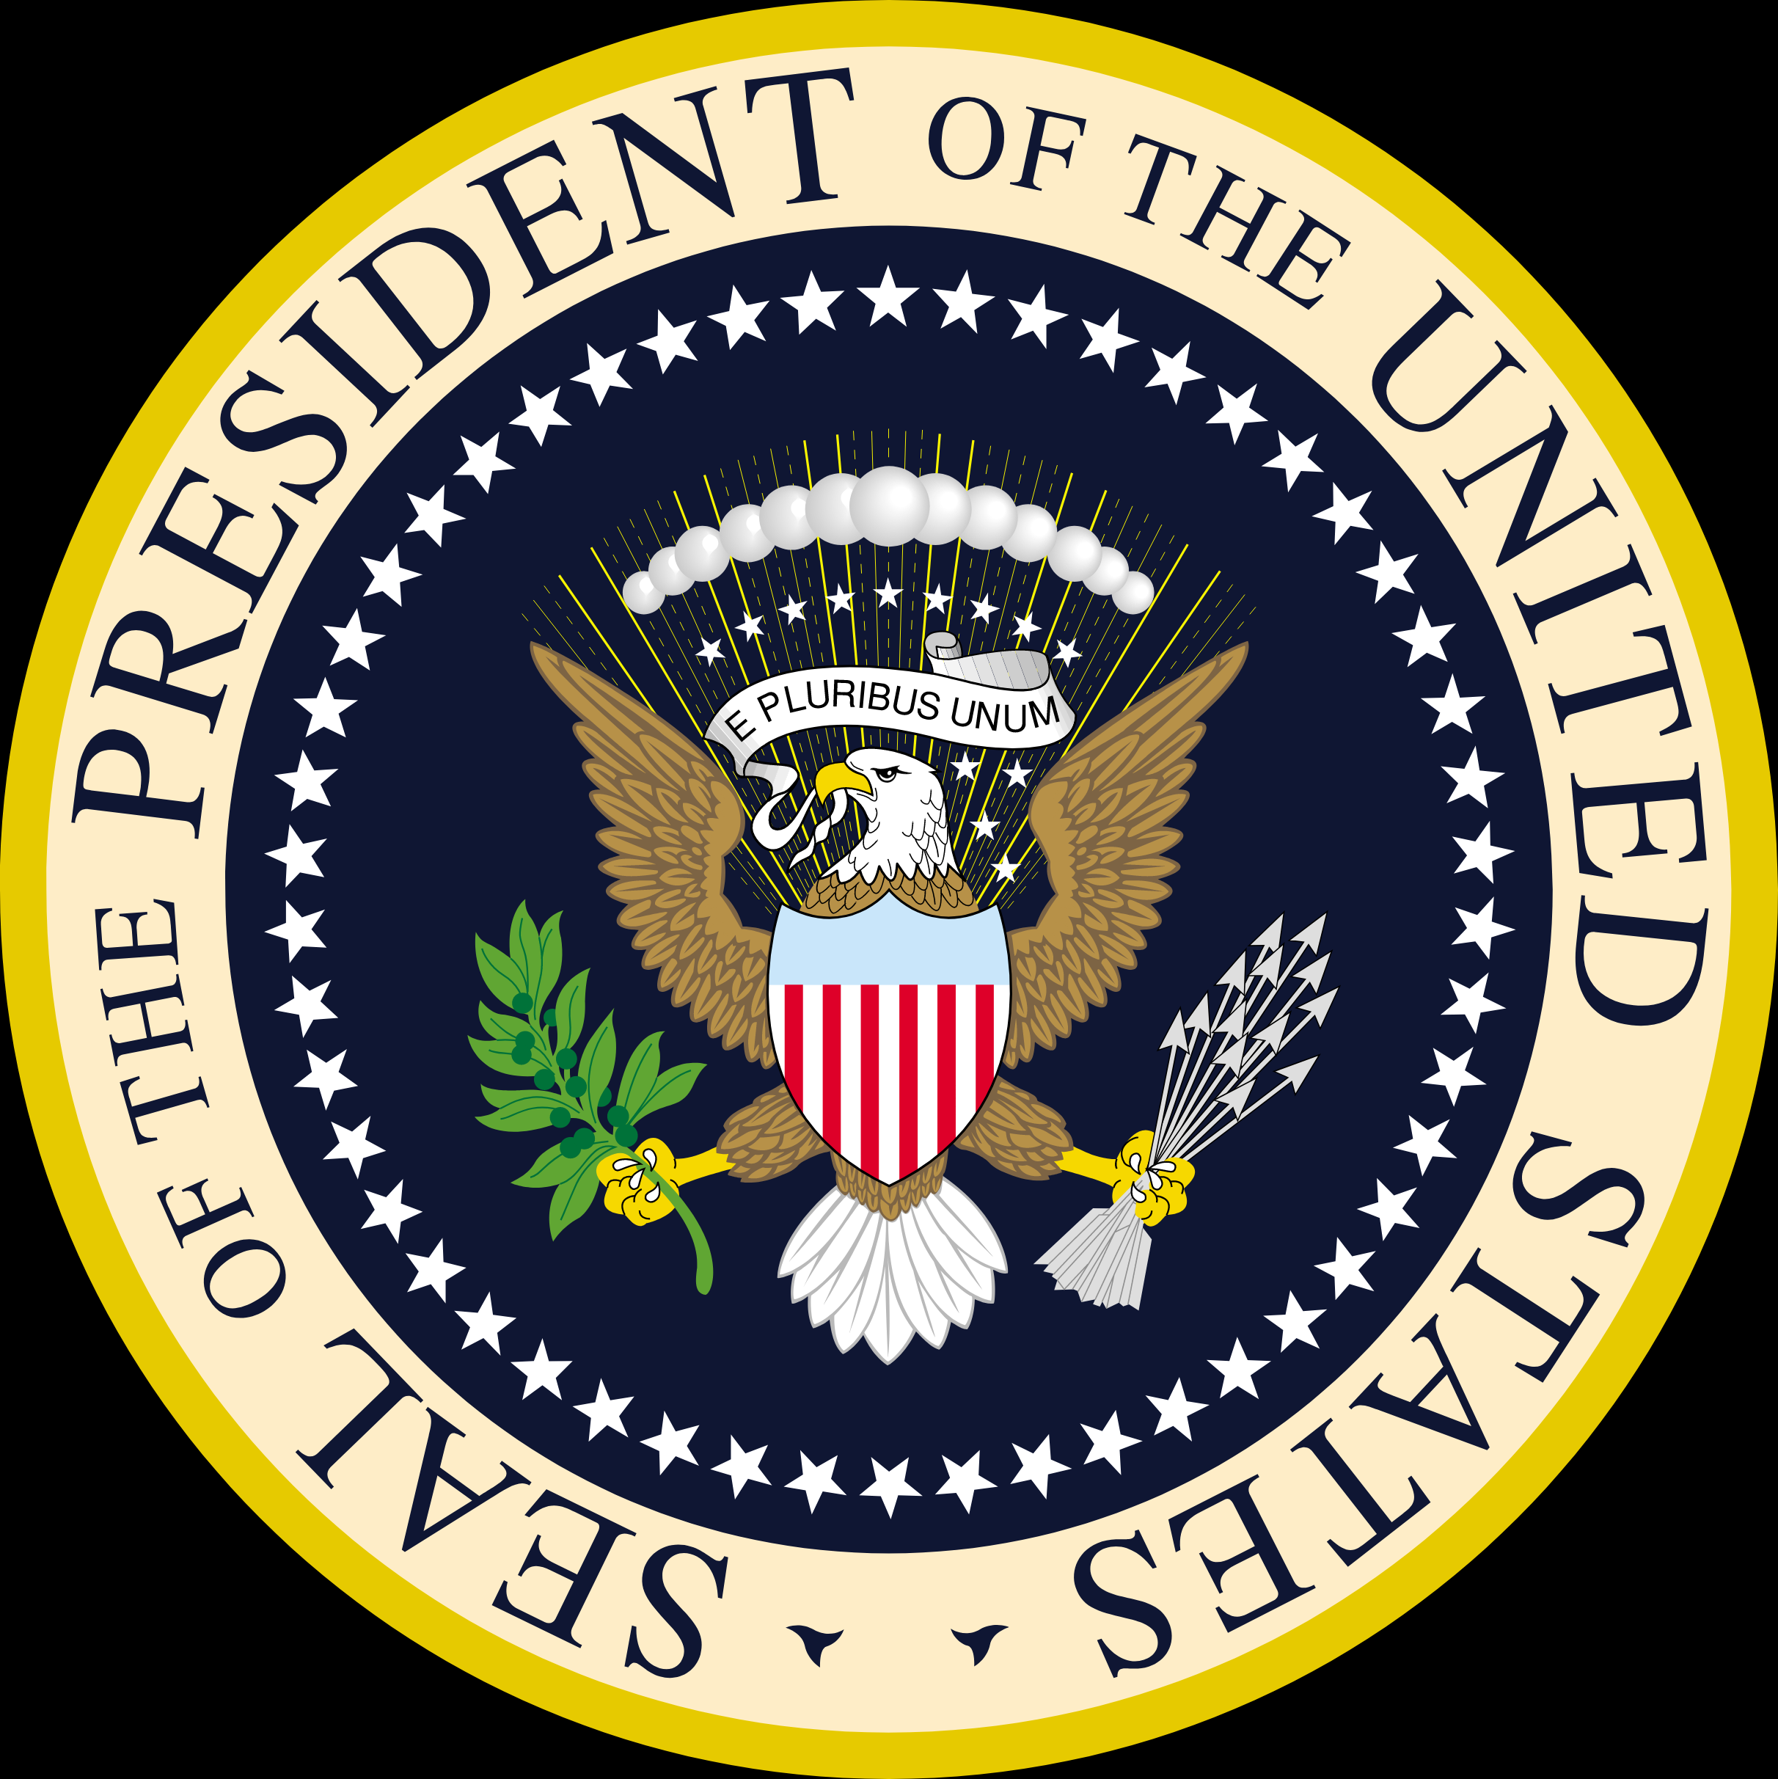
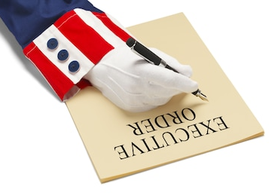
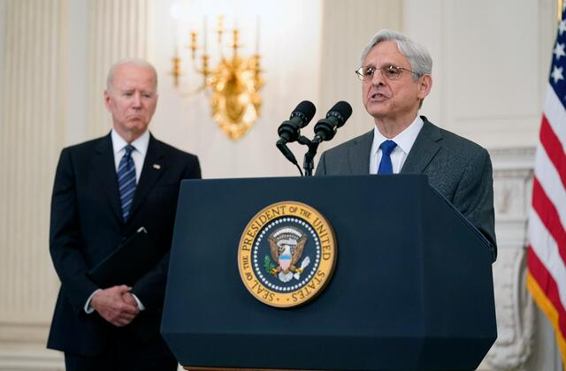
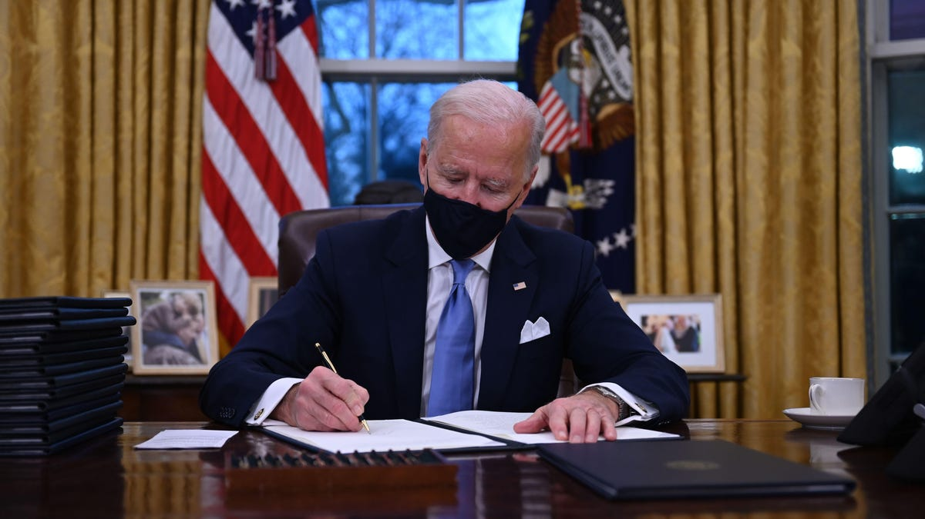
What are the Executive Powers of the President?
The Constitution endows the President with an enormous amount of authority. They are divided by domestic/public policy and foreign policy.
DOMESTIC/PUBLIC POLICY POWERS
Execututing the Law: executes and enforces all federal laws.
Ordinance Power: power to issue Executive Orders to implement and enforce federal law
The Appointment Power: power to name top-ranking officers of the Federal Government w/Senate consent

Slide 6
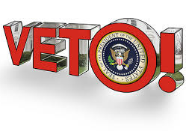
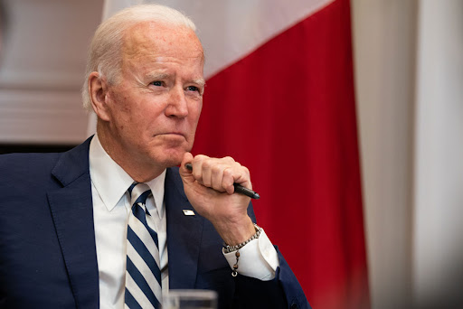
What are the Executive Powers of the President?
The Removal Power: Power to remove presidentially appointed officers
Veto Power: Power to sign a bill into law or veto the bill sending it back to Congress.

Slide 7
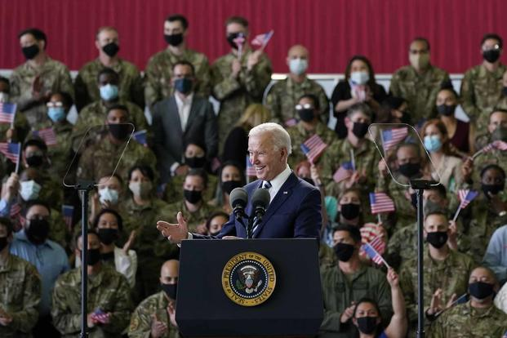
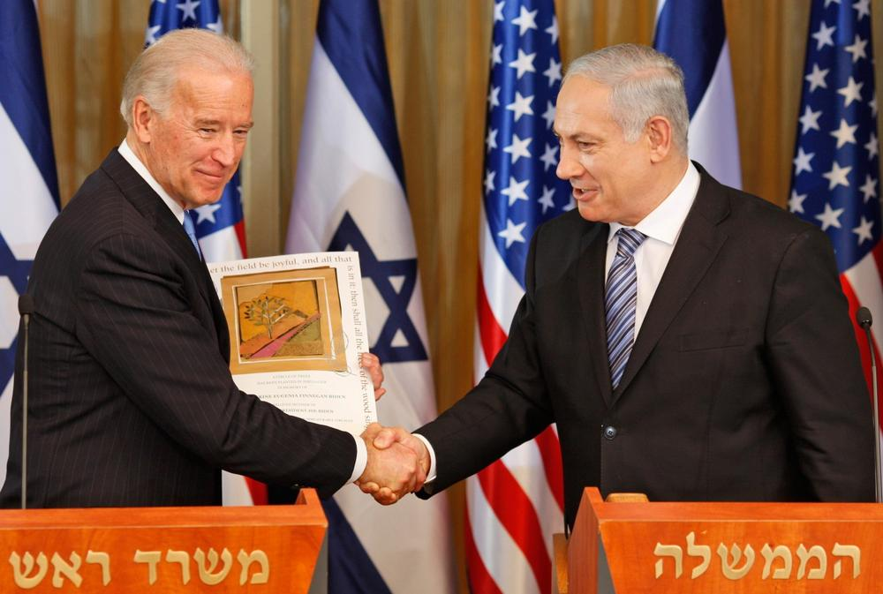
What are the Executive Powers of the President?
FOREIGN POLICY POWERS
Power to Make Treaties: Power to negotiate, through Department of State, formal agreements with other nations. Requires Senate consent
Power of Recognition: power to formally recognize the legal existence of another sovereign nation
Commander in Chief: President has the final authority over, and responsibility for, all military matters with most critical military decisions made as the Commander in Chief with the advice of subordinate military leaders

Slide 8
Civics Literacy Program:
Role, Responsibilities, and Powers of the President
COURSE LEARNING OBJECTIVES :
Students will have a better understanding of how the government of the United States is structured; how it works, and their roles and responsibilities within it.
FOCUS QUESTIONS:
1.7.1 What are the primary roles of the POTUS?
1.7.2 What are the primary roles of the VPOTUS?
1.7.3 What are the executive powers of the POTUS?

