Slide 1
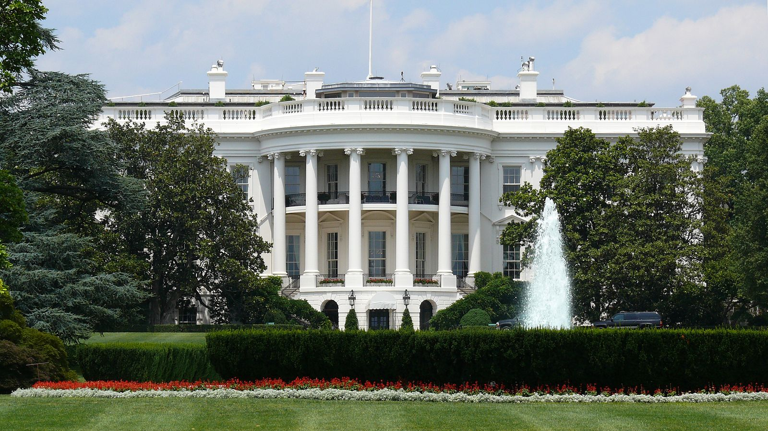
Civics Literacy Program
Overview of the Executive Branch

Slide 2
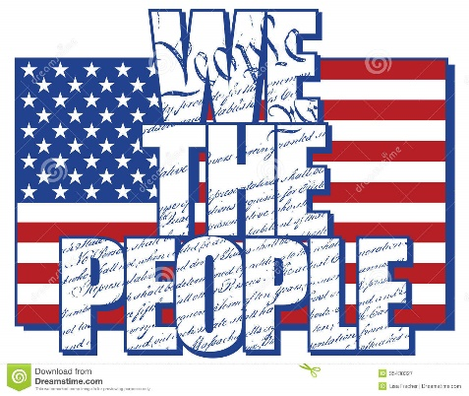
Civics Literacy Program:
Overview of the Executive Branch
COURSE LEARNING OBJECTIVES :
Students will have a better understanding of how the government of the United States is structured; how it works, and their roles and responsibilities within it.
LESSON LEARNING OBJECTIVES:
1.6.1 What are the qualifications for President of the United States (POTUS)?
1.6.2 What is the method of election to and terms of POTUS?
1.6.3 How is the Executive Branch structured?
1.6.4 What are the key positions within the Executive Branch and who currently holds them?

Slide 3
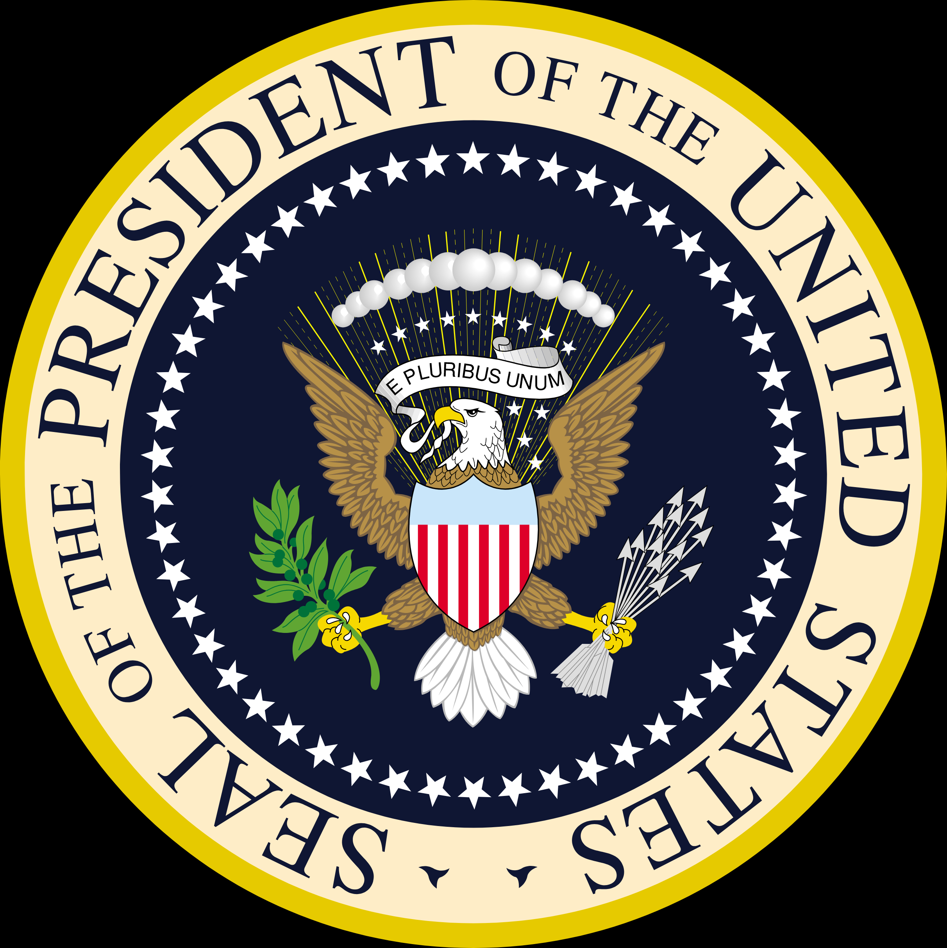
The President of The United States
The President is the only elected official representing the whole nation
The qualifications to hold office of President of the United States include:
must be at least 35 years of age
must be a natural-born citizen of the United States
must have been a resident of the US for fourteen years.
The term of service is four years with the ability to serve one additional term of service if reelected. (Changed by 22nd Amendment 1951)

Slide 4
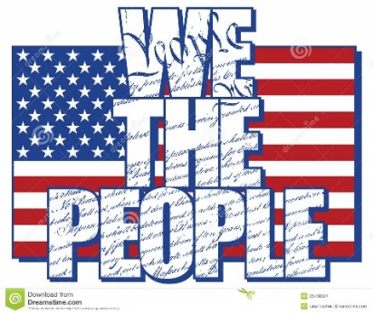
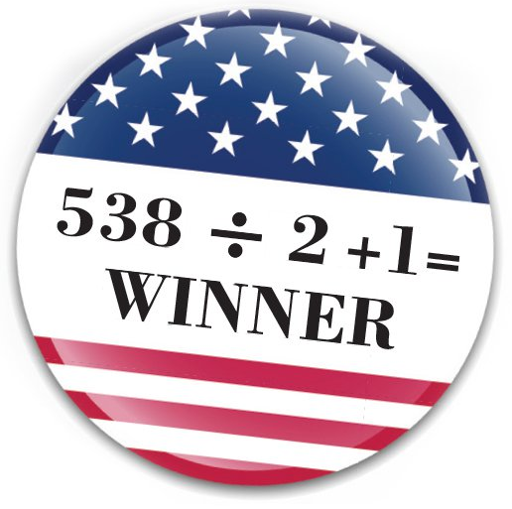
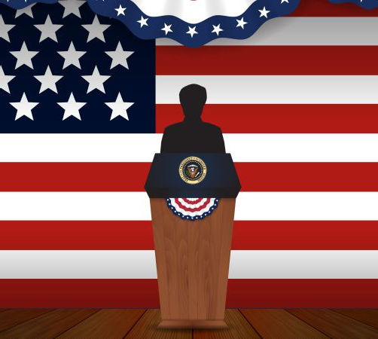
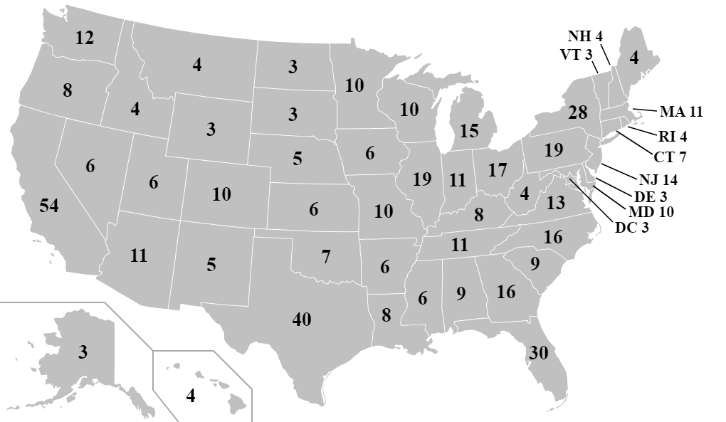
How is the President Elected?
The method used to elect the POTUS is called the Electoral College. Because the Framers did not wish to have such a powerful and important office directly elected by the people nor selected by the Congress, they devised an elaborate combination of both.
In the Electoral College, each state has a number of votes equivalent to its combined number of US Senators (2) and US Representative in the House (based on population)
To win the Presidency, a candidate must receive a simple majority of 270 votes of the 538 votes available.

Slide 6
How is the Executive Branch structured?
Article II of the Constitution establishes the Presidency and the Executive Branch. In its growth and development throughout the years a large bureaucracy has formed to help execute, enforce, and administer the day-today business of the Executive Branch; often referred to as the Administration.
The Executive Administration has three divisions:
Executive Office of the President
Executive Departments (Cabinets)
Independent Agencies
President
Vice President
Executive Office of the President
Executive Departments
Independent Agencies

Slide 7
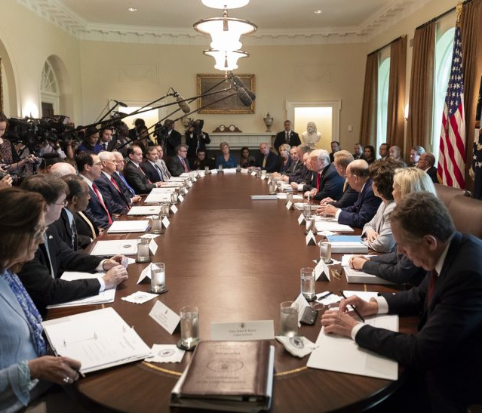
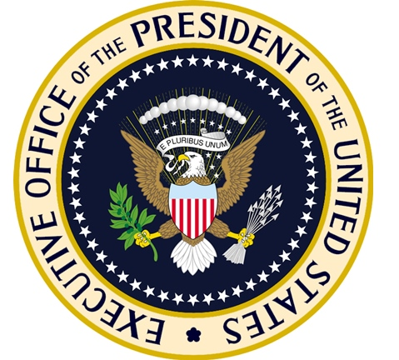
The Executive Office
The Executive Office of the United States: Established by Congress in 1939, it serves as the President’s umbrella agency staffed by his closest advisors and assistants and helps in the exercise of executive power and decision making.
Helps President carry out day-to-day responsibilities
Important EOP Offices:
National Security Council
Office of Management and Budget (OMB)
Council of Economic Advisors

Slide 8
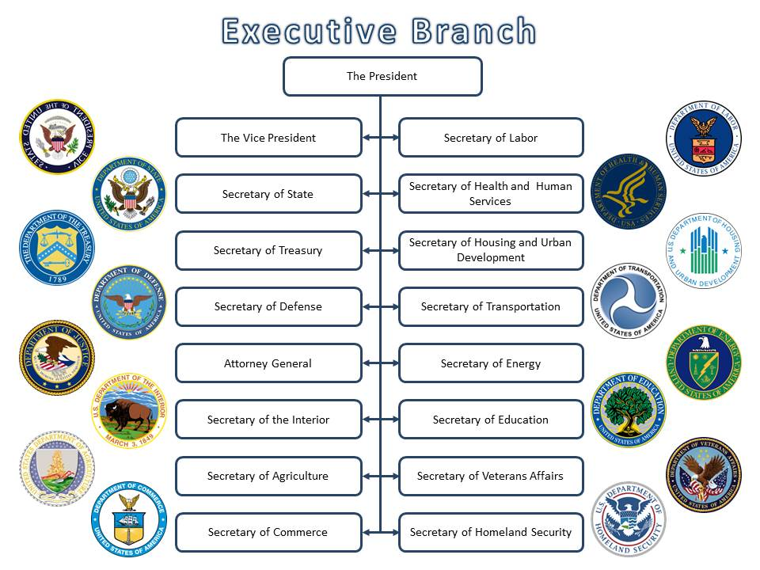
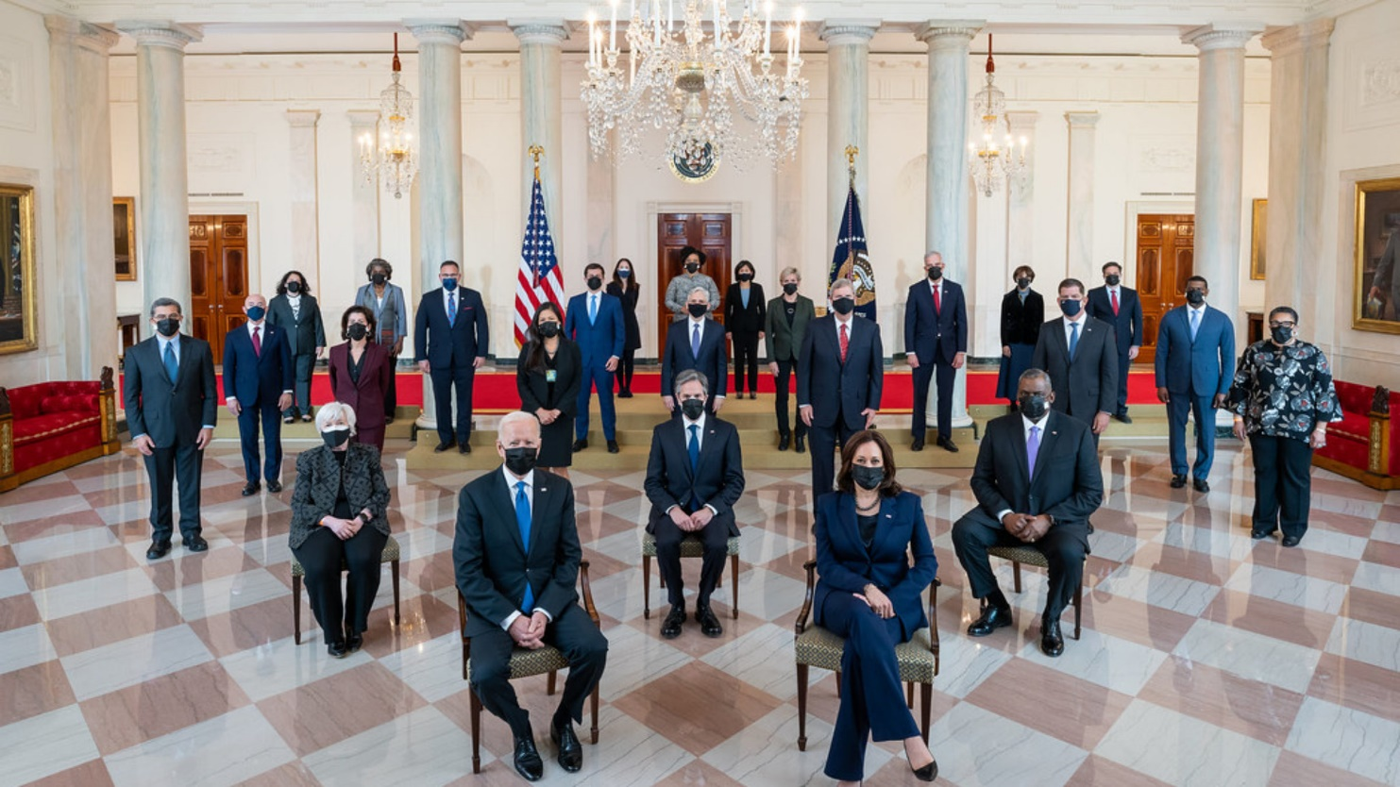
The Executive Departments
The Executive Departments: Established by President Washington in 1789, often referred to as Cabinet departments, they serve as the traditional units of federal administration divided into broad fields. There are currently 15 executive departments.
They serve as the president's primary means of implementing policy and enforcing law

Slide 9
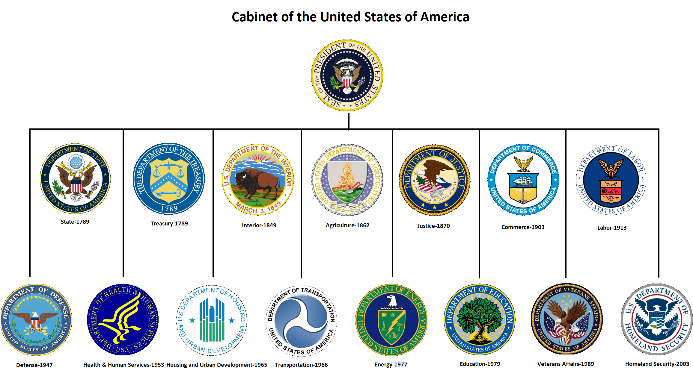

Slide 10
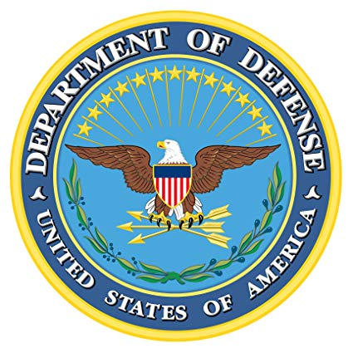
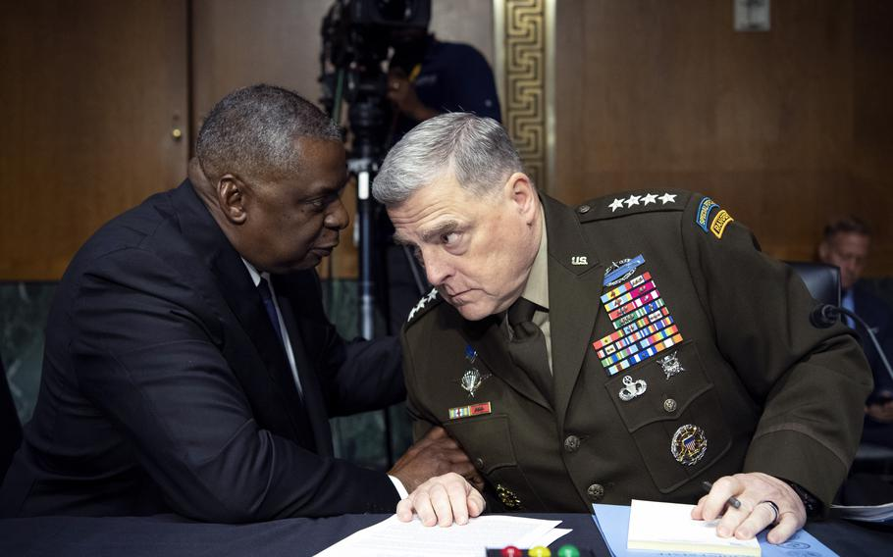
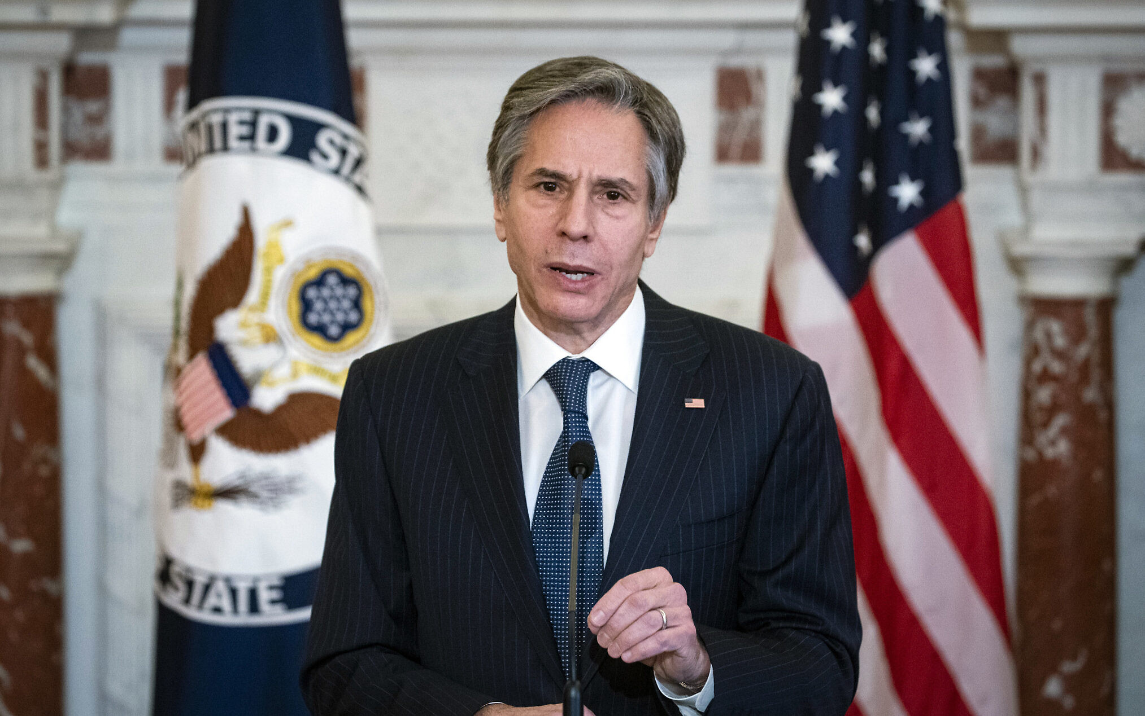
Executive Departments: The Big Four
The Department of State: Advises POTUS on foreign policy; represents the US abroad.
Headed by Secretary of State and subordinate US Ambassadors.
The Department of Defense: Provides military forces to deter/fight wars and protect nation’s security
Headed by Secretary of Defense and Chairman Joint Chiefs of Staff

Slide 11
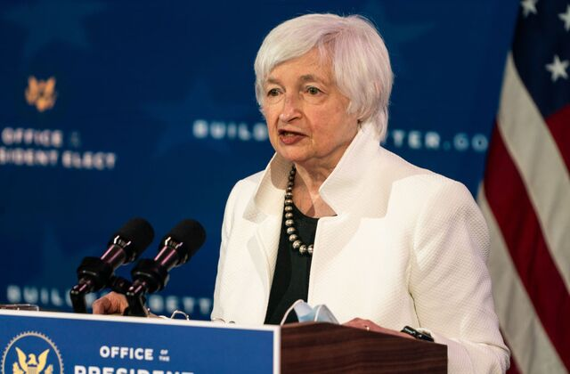
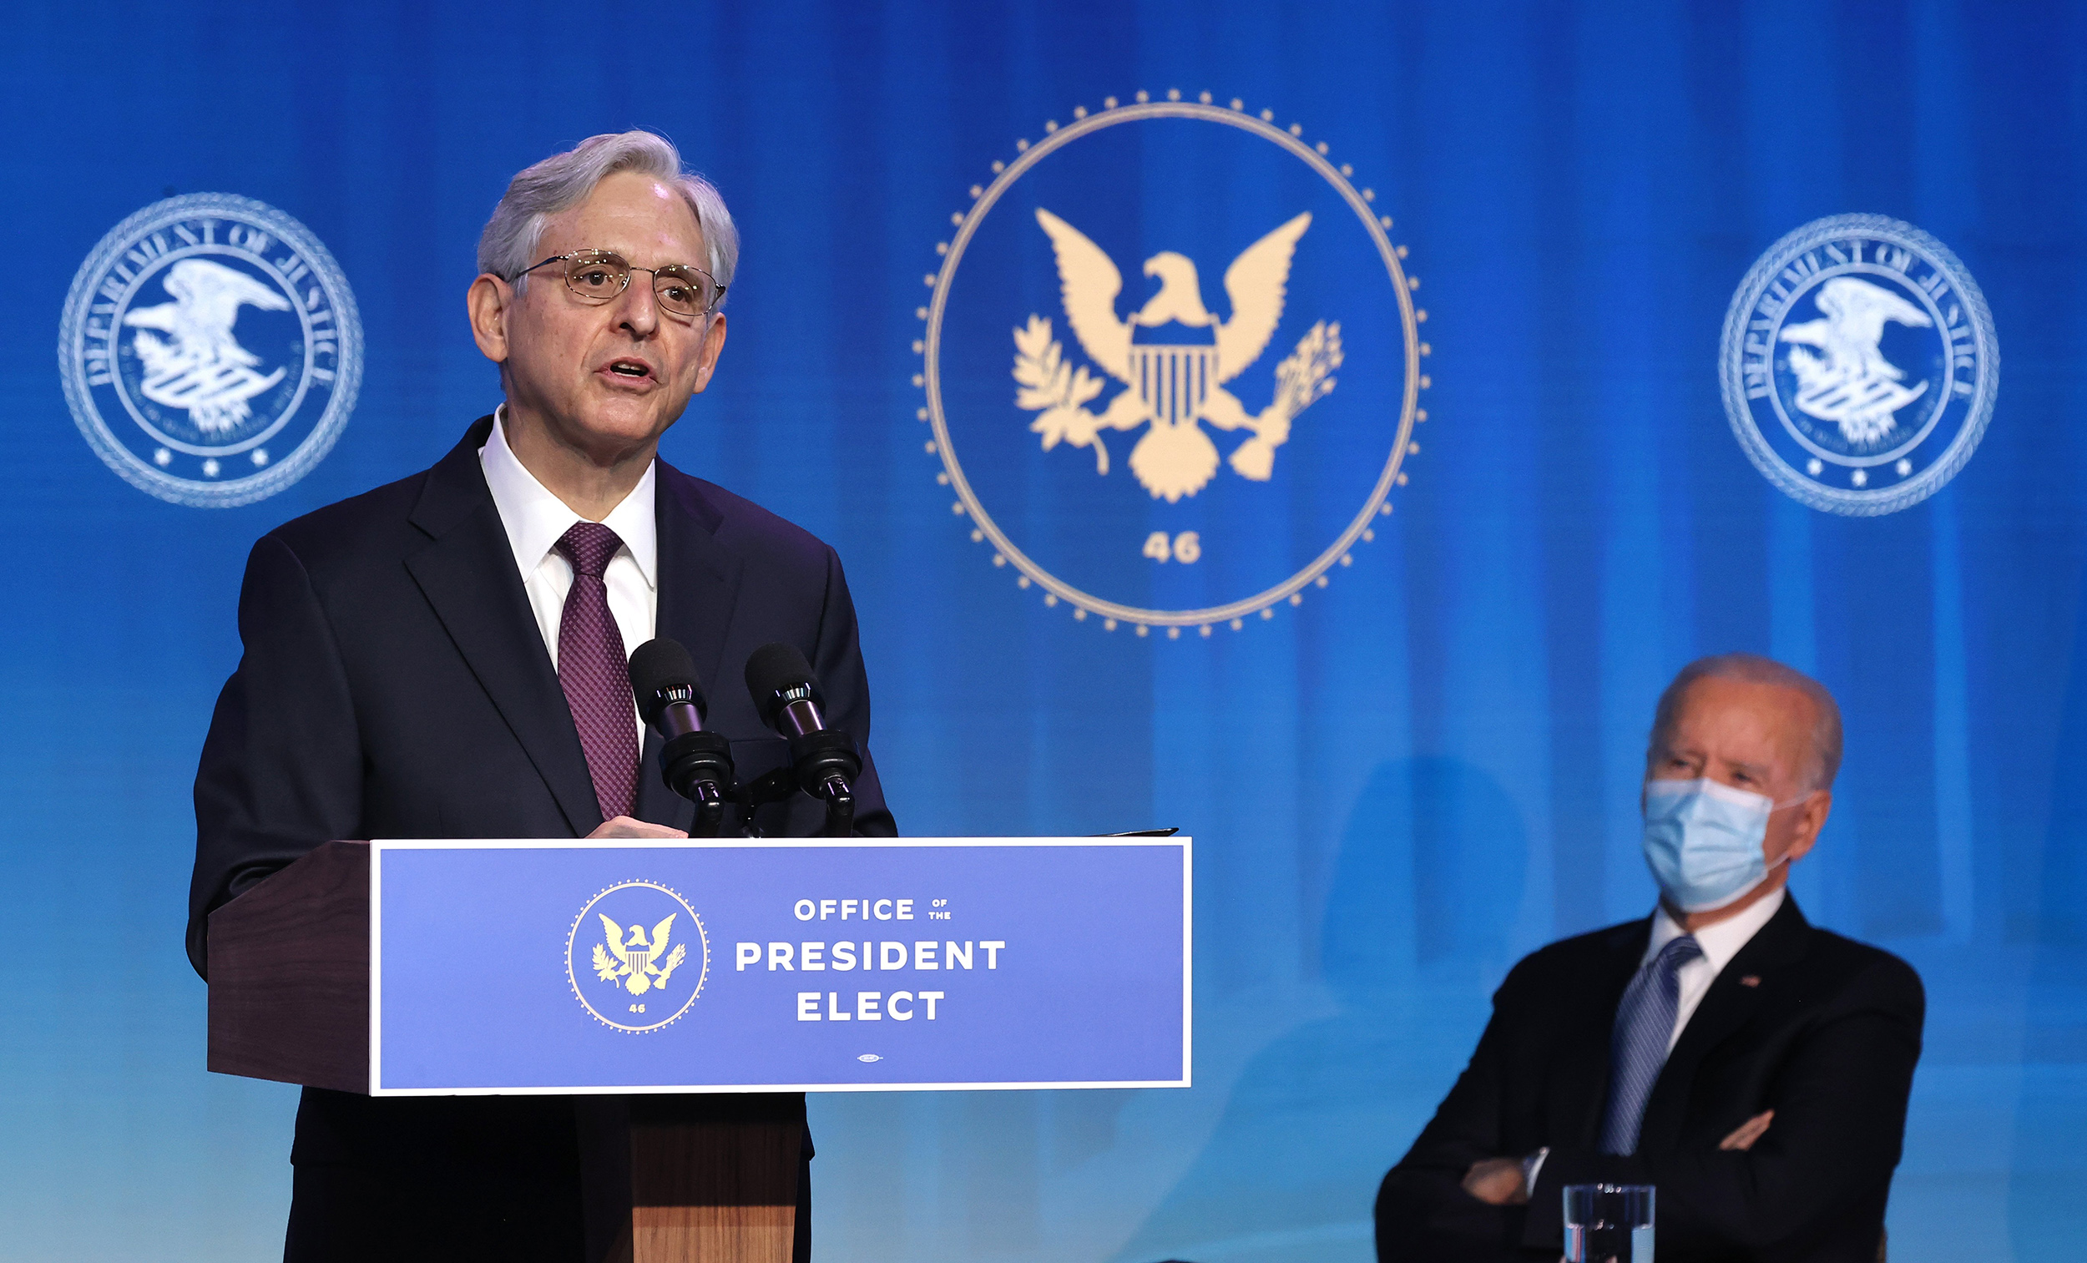
Executive Departments: The Big Four
The Treasury Department: Produces coins/bills; collect taxes (IRS); borrows money and manages public debt; enforces alcohol, tobacco, and firearms laws(ATF)
Headed by Treasury Secretary
The Department of Justice: Prosecutes federal crimes; enforces federal laws (FBI, DEA); provides legal advice to president; represents US in federal court
Headed by Attorney General

Slide 12
Independent Agencies
There are nearly 150 Independent Agencies in the Executive Branch. Each charged with administering specific/specialized government programs headed by a Director
The more important of these include:
Central Intelligence Agency (CIA)
Environmental Protection Agency (EPA)
Federal Reserve (The Fed)
National Aeronautics and Space Administration (NASA)
US Postal Service
Social Security Administration

Slide 13
Civics Literacy Program:
Overview of the Executive Branch
COURSE LEARNING OBJECTIVES :
Students will have a better understanding of how the government of the United States is structured; how it works, and their roles and responsibilities within it.
REVIEW QUESTIONS:
1.6.1 What are the qualifications for President of the United States (POTUS)?
1.6.2 What is the method of election to and terms of POTUS?
1.6.3 How is the Executive Branch structured?
1.6.4 What are the key positions within the Executive Branch and who currently holds them?

