Slide 1
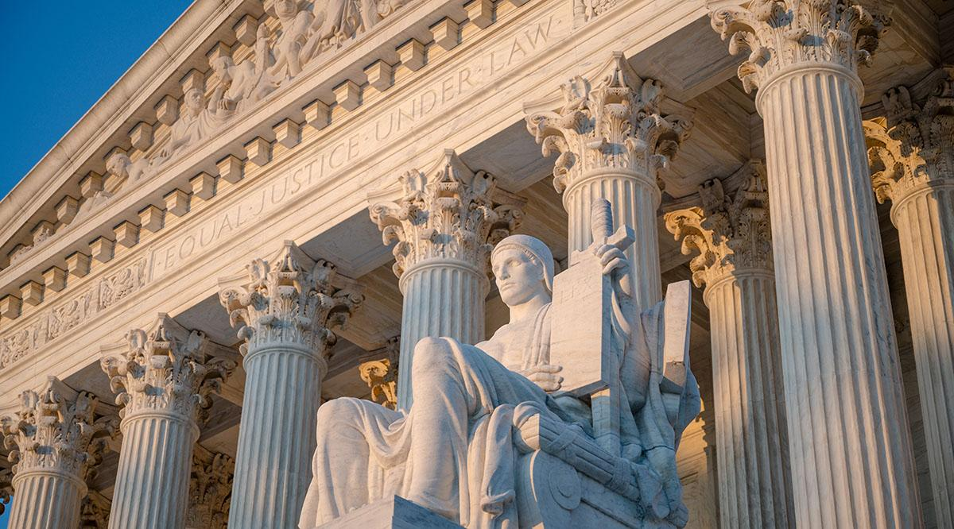
Civics Literacy Program
Overview of the Judicial Branch

Slide 2
Civics Literacy Program:
Overview of the Federal Court System
COURSE LEARNING OBJECTIVES :
Students will have a better understanding of how the government of the United States is structured; how it works, and their roles and responsibilities within it.
LEARNING OBJECTIVES:
1.8.1 What types of courts make up the Federal Court System? What are their roles?
1.8.2 What is a dual court system? How does it work?
1.8.3 What is the current make-up of the Supreme Court of the United States (SCOTUS)? How does it operate?

Slide 3
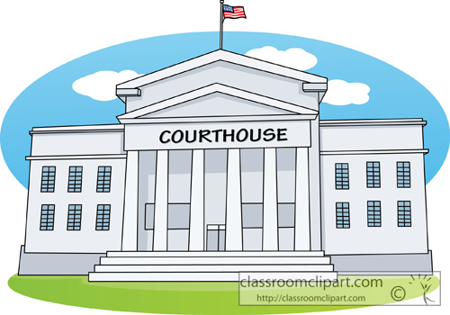
What types of courts make up the Federal Court System? What are their roles?
When the Federal Court System was created under the provisions of Article III of the Constitution in 1789, there were already courts operating in the several states, so the Federal Court System was structured to mirror the states’ systems, but at the national level.
Federal Courts’ jurisdiction (authority to try and decide cases) is over most cases involving federal law/Constitution and/or cases involving US or States’ government.

Slide 4
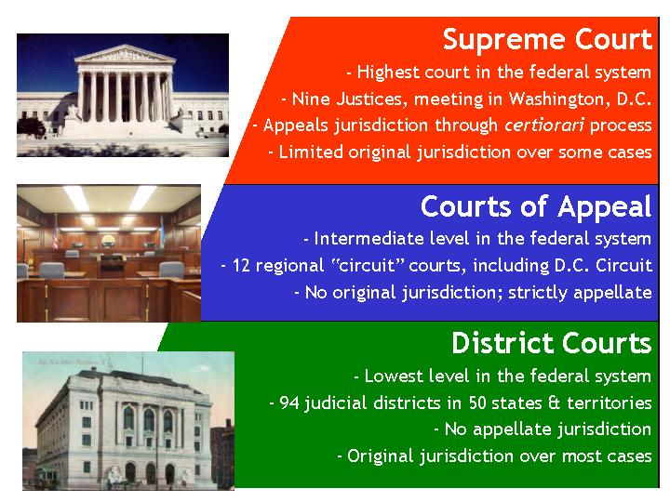
What types of courts make up the Federal Court System? What are their roles?
The Federal Court System has two levels:
The Supreme Court: The highest court in the land; the court of last resort in all questions of federal law. Most cases are heard on appeal from a lower district/state court. It is the final authority on the interpretation of the Constitution and Federal law
Inferior (Lower) Courts: courts created by the Congress to function below the SCOTUS; they make up the core of the federal court system: Made up primarily by the 94 District Courts throughout the US and 13 US Courts of Appeal (Circuit Courts)

Slide 5
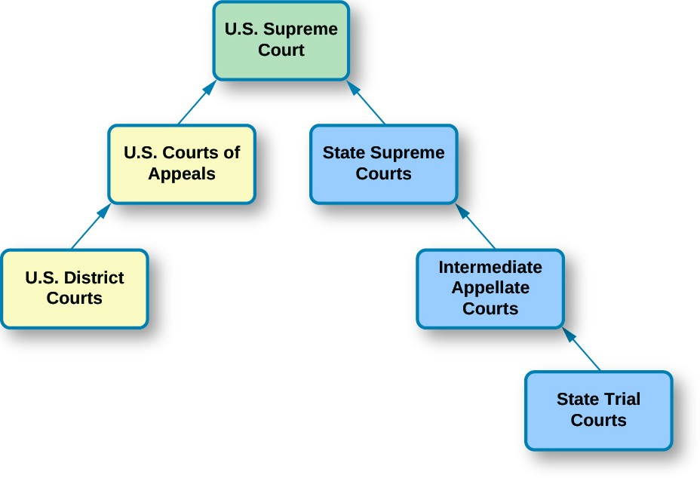
What is a dual court system? How does it work?
Under Federalism, there are two separate court systems in the United States. The national judiciary spans the country with more than 100 courts. However, each of the 50 States has its own system of courts. These number well into the thousands. Most cases heard in the court today are heard in these State courts, not the federal courts.
They sometimes share jurisdiction (concurrent) but most often jurisdiction is exclusive to one or the other.
KNOW THIS GRAPHIC

Slide 6
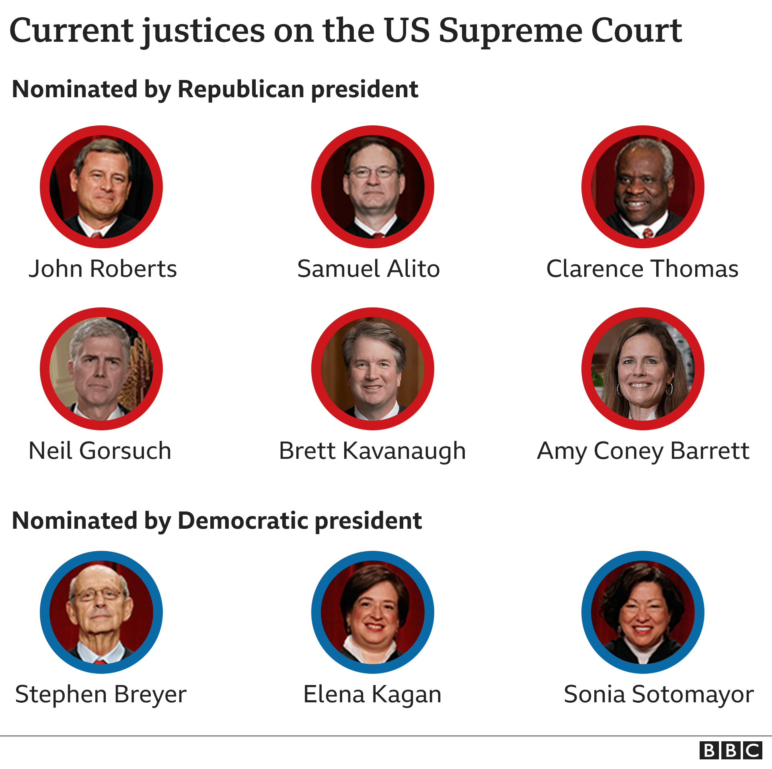
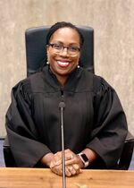
What is the current make-up of the Supreme Court of the United States (SCOTUS)?
The current make-up of the SCOTUS has nine Supreme Court Justices, one of which is the Chief Justice (John Roberts) others titled Associate Justices.
An odd number always ensures that there are no ties in voting. However, sometimes it is necessary for a Justice to recuse (remove) themselves from a case if they had any prior interest in the case or relationship with the participants before their appointment to SCOTUS.
Ketanji Brown Jackson

Slide 7
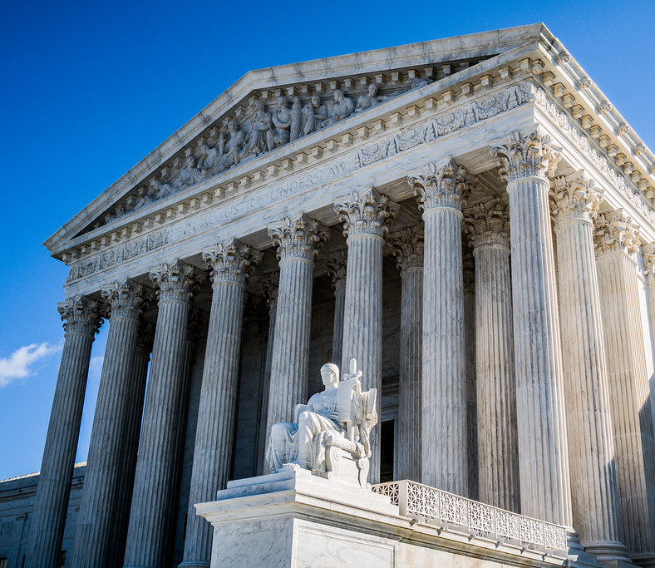
How does the Supreme Court of the United States Operate?
Each year nearly 8,000 cases are appealed to the SCOTUS. Of these, the SCOTUS usually only considers a few hundred for decision. Most are denied b/c they concur with the lower court's decision, or the case involves no significant point of law.
Most cases accepted by the SCOTUS are disposed of in brief orders (written decisions). These orders may return the case back to the lower court for reconsideration.
All in all, the SCOTUS usually hears (arguments with full opinions) fewer than 100 cases per year.

Slide 8
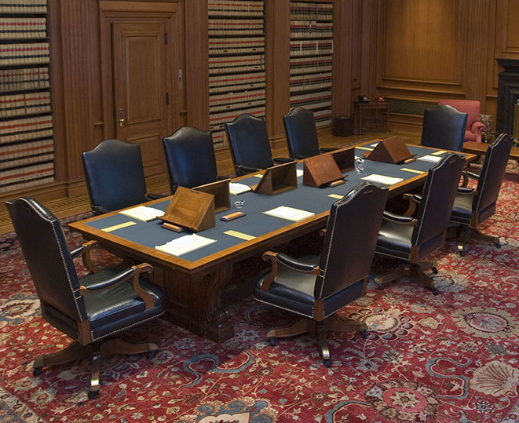
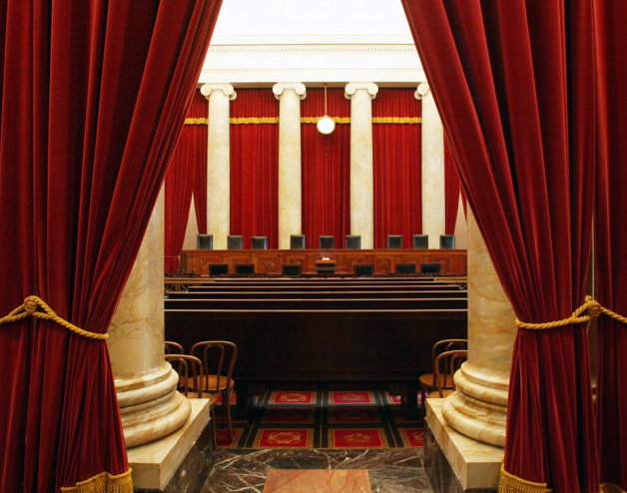
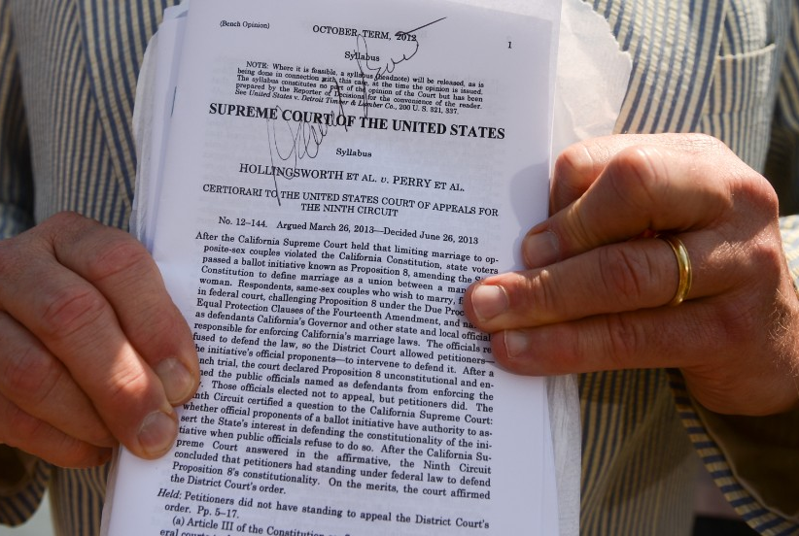
How does the Supreme Court of the United States Operate?
In those cases, heard by the SCOTUS, ①oral arguments are heard by the Justices from both sides of the case.
Afterwards, usually on Wednesdays and Fridays, the justices meet in ②conference to consider/debate the merits of each side applying federal law and precedent (previous decisions of SCOTUS).
After a ③decision is made, the Court issues (hands down) its opinion (majority opinion) and the dissenting opinion. All decisions are binding.

Slide 9
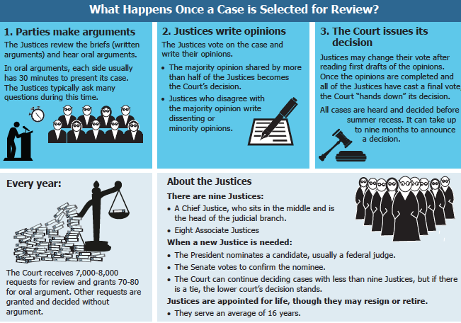

Slide 10
Civics Literacy Program:
Overview of the Federal Court System
COURSE LEARNING OBJECTIVES :
Students will have a better understanding of how the government of the United States is structured; how it works, and their roles and responsibilities within it.
REVIEW QUESTIONS:
1.8.1 What types of courts make up the Federal Court System? What are their roles?
1.8.2 What is a dual court system? How does it work?
1.8.3 What is the current make-up of the Supreme Court of the United States (SCOTUS)? How does it operate?

